Slide 1


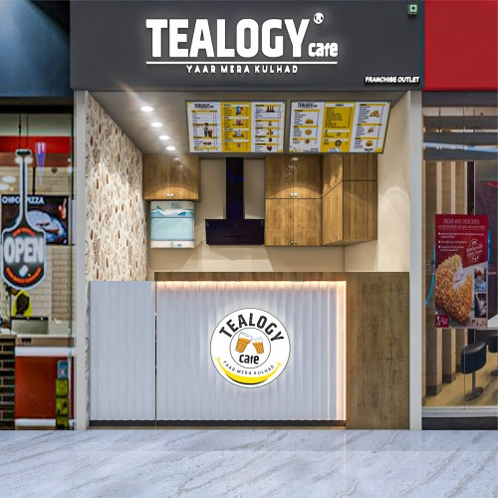
BEST CAFE FRANCHISE
START YOUR DREAM CAFE WITH TEALOGY
Looking for the Best Cafe Franchise? Tealogy offers a perfect opportunity to start your own cafe business with complete franchise support. We provide premium tea, coffee, delicious snacks, store setup assistance, staff training, and marketing support. Our business model is simple, profitable, and designed to help entrepreneurs achieve long-term success.
https://tealogy.in/teacafe-franchise

Slide 2
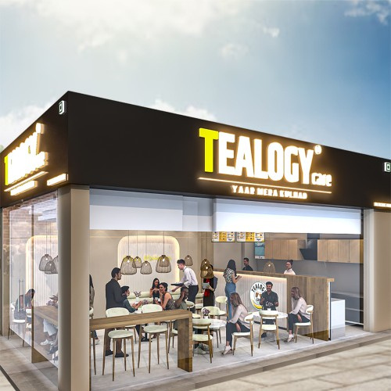

WHY CHOOSE TEALOGY?
START YOUR DREAM CAFE WITH TEALOGY
Tealogy is known for quality products and reliable franchise support. We help you at every stage of your business, from planning and setup to daily operations. With our premium menu, strong brand value, and expert guidance, you can confidently run your cafe and attract more customers.

Slide 3
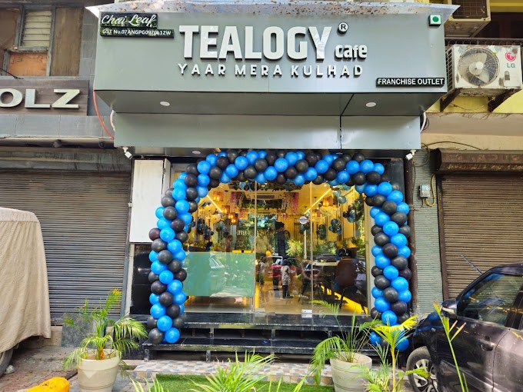
GROW WITH TEALOGY
BUILD A PROFITABLE CAFE BUSINESS
Choosing the Best Cafe Franchise with Tealogy gives you the opportunity to build a successful business with low investment and high growth potential. We offer continuous support, quality products, and effective marketing assistance to help your cafe grow. Join Tealogy and take the first step towards becoming a successful cafe owner.

Slide 4
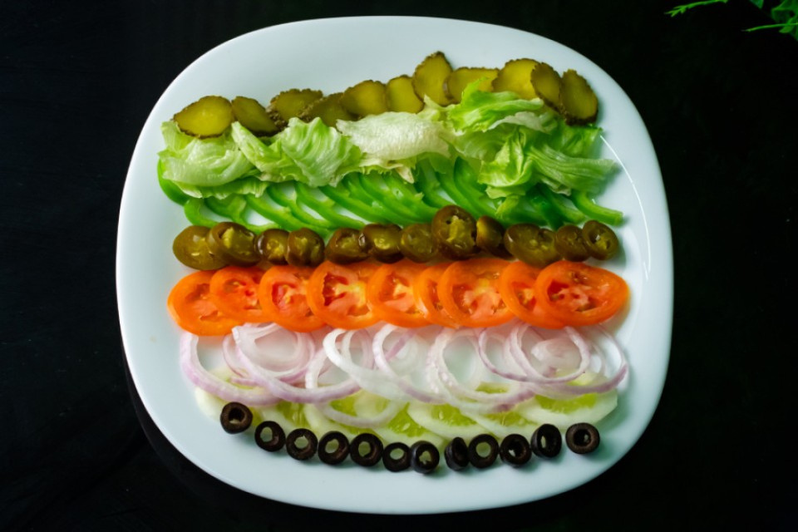
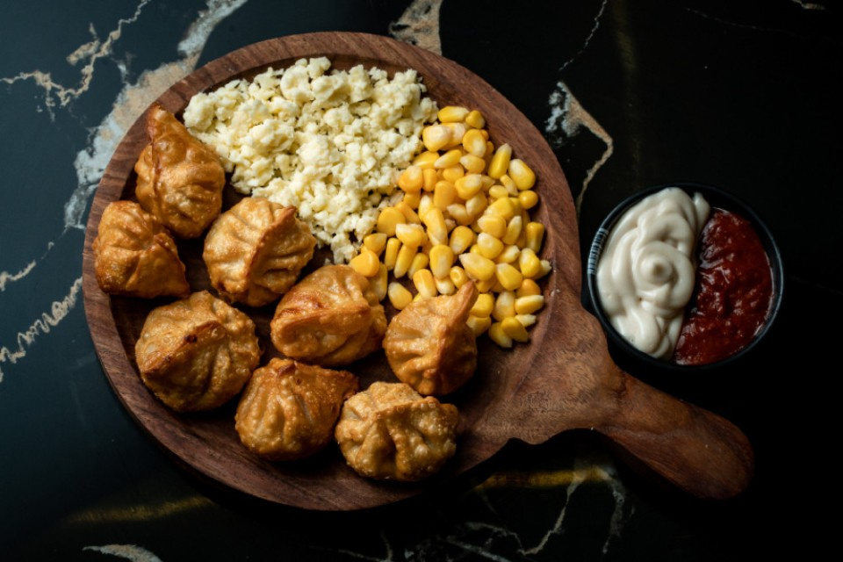

CONTACT DETAILS
Address - 503-A/B, 5th Floor Princess Business Sky Park
Block no. 23,24 SCH No.54, PU-3 Commercial,
Opp C21, AB Rd, Indore, Madhya Pradesh 452001
Phone: +91-6269112500/ +91-6269120500
Email: business@tealogy.in

Slide 5
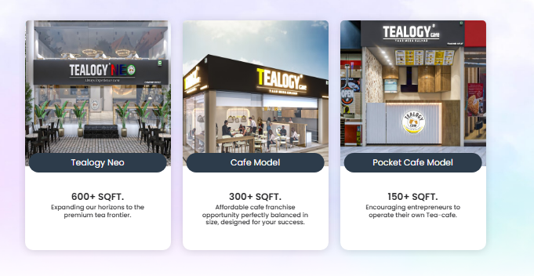
THANK YOU
To know more, please read this - https://tealogy.in/teacafe-franchise

