Slide 1

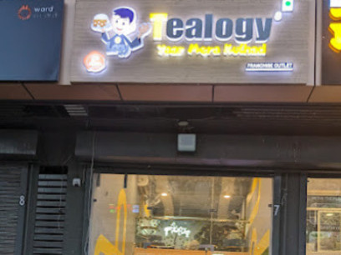
Affordable Cafe Franchise with Tealogy
Affordable Cafe Franchise – Start with Tealogy
Looking for an Affordable Cafe Franchise? Tealogy offers a great opportunity to start your own cafe business with a budget-friendly investment. Our franchise model is designed for aspiring entrepreneurs who want to enter the cafe industry with complete business support. From setup to daily operations, Tealogy helps you at every step to build a successful and profitable cafe.
https://tealogy.in/teacafe-franchise

Slide 2
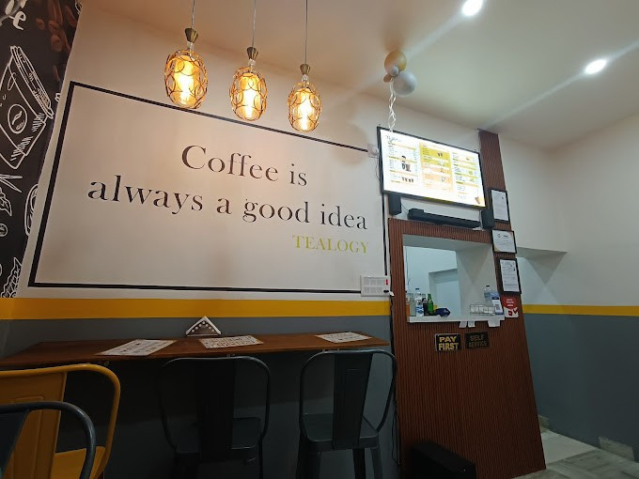
Why Choose Tealogy?
Why Tealogy is the Right Choice
Choosing Tealogy means partnering with a trusted cafe brand. We provide premium tea and coffee products, staff training, store setup guidance, marketing support, and operational assistance. Our Affordable Cafe Franchise model helps you start your business with confidence while delivering quality products and excellent customer service.

Slide 3
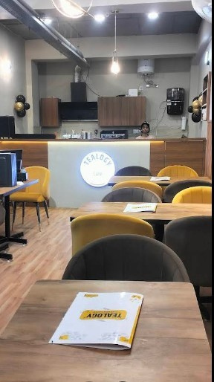
Build Your Successful Cafe Business
Grow Your Business with Tealogy
An Affordable Cafe Franchise from Tealogy gives you the chance to create a successful business with long-term growth. With a strong brand name, quality products, and continuous franchise support, you can attract more customers and increase your profits. Join Tealogy today and take the first step toward becoming a successful cafe owner.

Slide 4

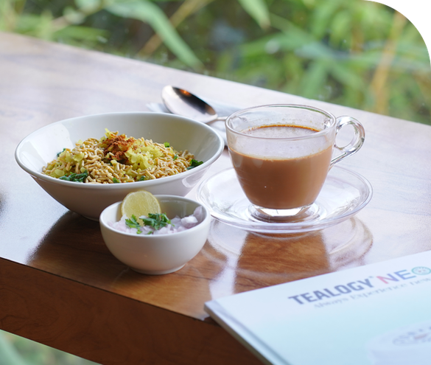
Thank You
CONTACT DETAILS
Address - 503-A/B, 5th Floor Princess Business Sky Park
Block no. 23,24 SCH No.54, PU-3 Commercial,
Opp C21, AB Rd, Indore, Madhya Pradesh 452001
Phone: +91-6269112500/ +91-6269120500
Email: business@tealogy.in / Visit - https://tealogy.in/teacafe-franchise

