Slide 1

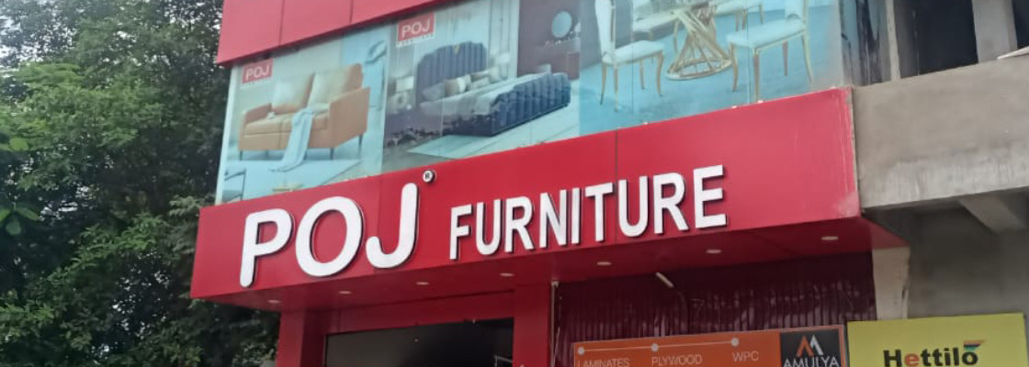




POJ Furniture
Furniture Store Franchise Opportunities
Presented By:
POJ Furniture
https://www.pojfurniture.com/franchisee

Slide 2
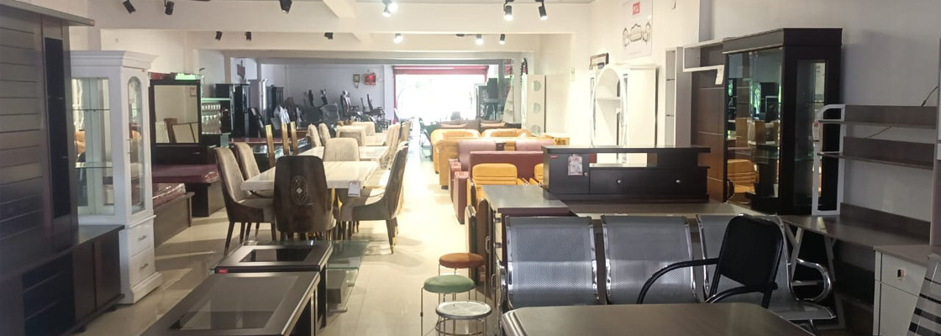
Furniture Store Franchise Opportunities
POJ Furniture offers excellent Furniture Store Franchise Opportunities for entrepreneurs looking to start a successful furniture business. With growing demand for home and office furniture, partnering with a trusted brand helps you build a profitable and long-term business.
  Trusted and established furniture brand
  Growing demand in the furniture market
  Opportunity for long-term business growth
  Support for showroom setup and operations
  Wide range of furniture collections

Slide 3

Why Choose POJ Furniture Franchise?
POJ Furniture provides complete business support and high-quality products to help franchise partners grow successfully. The brand focuses on stylish, durable, and affordable furniture that attracts customers from different markets.
  Premium furniture for home and office
  Modern and traditional furniture designs
  Affordable investment and profit potential
  Marketing and promotional support
  Reliable product supply and customer service

Slide 4

Start Your Business with POJ Furniture
Choose Furniture Store Franchise Opportunities with POJ Furniture and become part of a fast-growing furniture network. With strong brand support and increasing customer demand, you can create a stable and successful business in your city.
  Easy business setup guidance
  High-quality furniture collections
  Strong customer trust and brand value
  Fast-growing furniture industry opportunity
  Long-term growth and earning potential

Slide 5
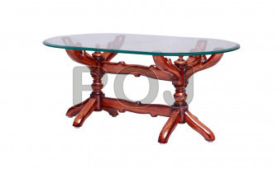


Thank you so much
  +91 993 905 5075
  M/S POJ FURNITURE BESIDE RANI SATI MANDIR, OPP HP PETROLPUMP, GOBINDPUR ROAD, PO- K G ASHRAM, DHANBAD Jharkhand - 828109
  https://www.pojfurniture.com/franchisee

