Slide 1



CAFE FRANCHISE IN NOIDA
START YOUR TEA CAFE BUSINESS WITH TEALOGY
Tealogy is a trusted Cafe Franchise in Noida offering quality tea, coffee, and delicious snacks. With a modern cafe setup and growing customer demand, Tealogy is a great business opportunity for new entrepreneurs.
  Affordable investment
  Strong brand support
  High customer demand
  Easy business model
https://tealogy.in/city/tea-cafe-franchise-noida

Slide 2


BENEFITS OF TEALOGY FRANCHISE
Tealogy helps franchise partners build a successful cafe business with complete support and guidance.
Our Support Includes
  Staff training
  Marketing assistance
  Interior setup support
  Product supply management
  Business operation guidance
Tealogy makes running a Cafe Franchise in Noida simple and profitable.

Slide 3
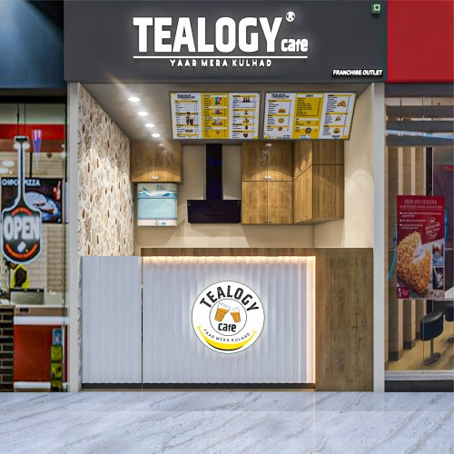
JOIN THE FAST-GROWING CAFE BRAND
Popular Products
  Kulhad Tea
  Flavored Tea
  Coffee & Cold Beverages
  Sandwiches & Fast Food
Start your journey with Tealogy and become a part of the growing Cafe Franchise in Noida market.

Slide 4

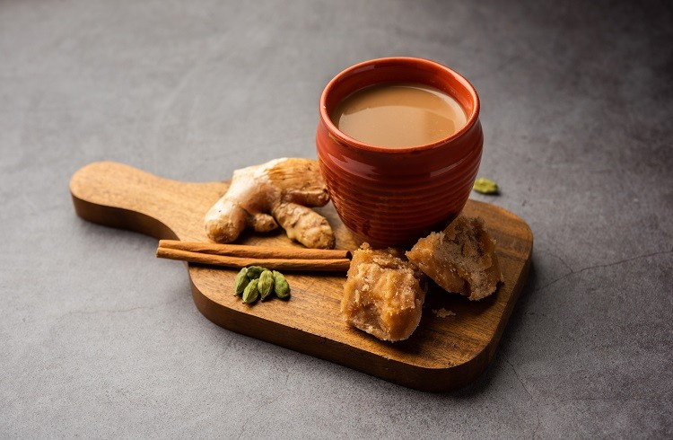

CONTACT DETAILS
Address - 503-A/B, 5th Floor Princess Business Sky Park
Block no. 23,24 SCH No.54, PU-3 Commercial,
Opp C21, AB Rd, Indore, Madhya Pradesh 452001
Phone: +91-6269112500/ +91-6269120500
Email: business@tealogy.in

Slide 5

THANK YOU
To know more, please read this - https://tealogy.in/city/tea-cafe-franchise-noida

