Slide 1


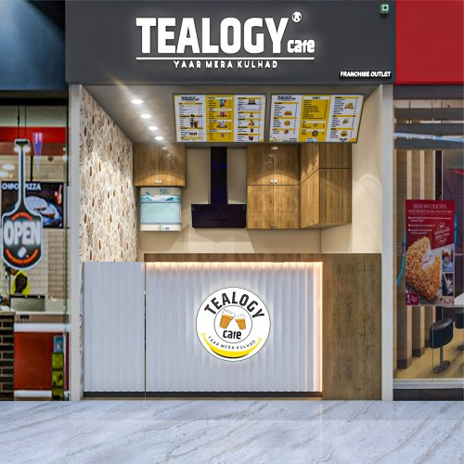

CAFE FRANCHISE IN GREATER NOIDA
Tealogy is a fast-growing Cafe Franchise in Greater Noida offering premium tea, coffee, and snacks. Our modern cafe concept and strong brand support help new entrepreneurs start a successful business with confidence.
https://tealogy.in/city/tea-cafe-franchise-greater-noida

Slide 2


WHY CHOOSE TEALOGY?
Benefits of Choosing Tealogy
  Trusted and growing tea cafe brand
  Affordable investment opportunity
  Stylish and modern cafe setup
  High demand for tea and snacks
  Full franchise training and support
Tealogy makes it easy to run a profitable Cafe Franchise in Greater Noida.

Slide 3

WHAT WE OFFER
Tealogy serves a wide range of:
  Kulhad Tea
  Flavored Tea
  Coffee
  Shakes
  Fast Food & Snacks
Our cafes provide a comfortable space where customers enjoy quality food and beverages with friends and family.

Slide 4
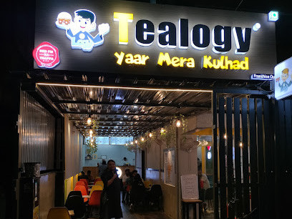

GROW WITH TEALOGY
Tealogy helps franchise partners with marketing, operations, and business guidance. With increasing demand for tea cafes, investing in a Cafe Franchise in Greater Noida can be a smart and profitable business decision.
CONTACT DETAILS
Address - 503-A/B, 5th Floor Princess Business Sky Park
Block no. 23,24 SCH No.54, PU-3 Commercial,
Opp C21, AB Rd, Indore, Madhya Pradesh 452001
Phone: +91-6269112500/ +91-6269120500
Email: business@tealogy.in

Slide 5

THANK YOU
To know more, please read this - https://tealogy.in/city/tea-cafe-franchise-greater-noida

