Slide 1

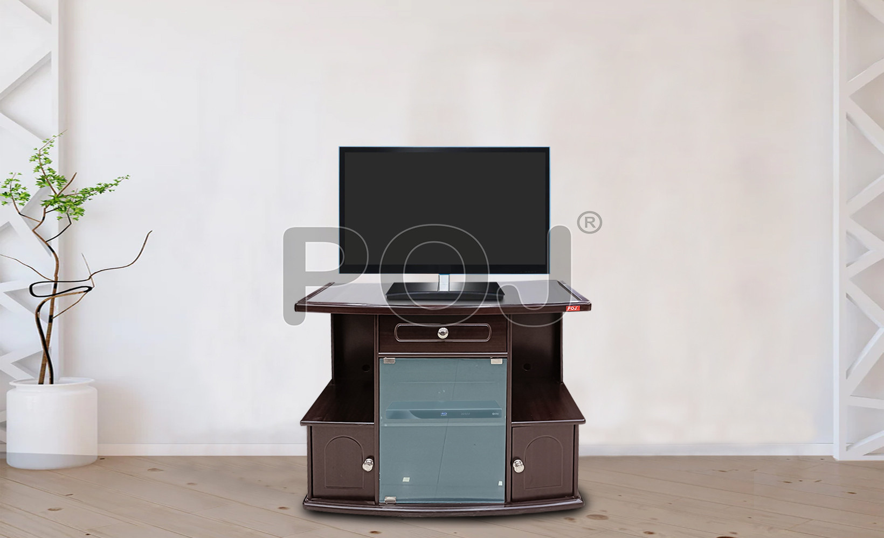




POJ Furniture
Wooden Furniture Shop in Bhubaneswar
Premium Wooden Furniture for Home & Office
Presented By:
POJ Furniture
https://www.pojfurniture.com/our-showrooms/bhubaneswar1

Slide 2
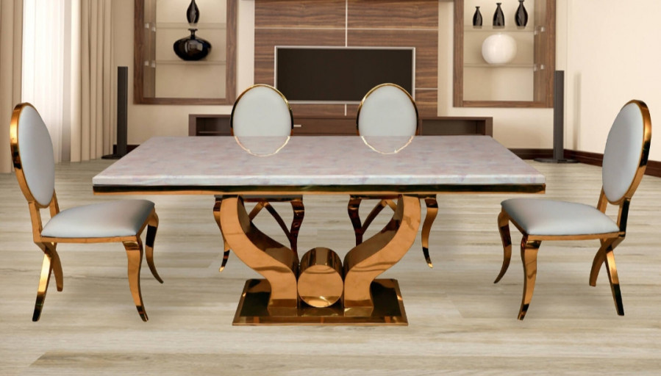
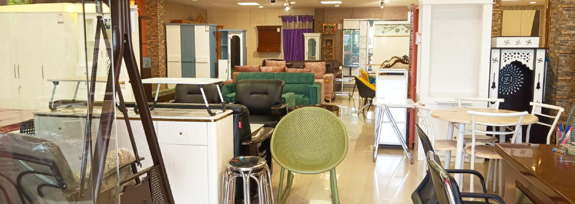
About POJ Furniture
Looking for a trusted Wooden Furniture Shop in Bhubaneswar? POJ Furniture offers high-quality, durable, and stylish wooden furniture crafted to suit both modern and traditional interiors. Our designs focus on comfort, elegance, and long-lasting performance.

Slide 3

Why Choose POJ Furniture?
  Premium solid wood craftsmanship
  Wide range of modern and classic designs
  Affordable pricing with great value
  Furniture for living room, bedroom, and office
  Trusted brand with reliable customer support

Slide 4

Our Collection & Benefits
Explore sofas, beds, dining sets, wardrobes, and more at the Wooden Furniture Shop in Bhubaneswar. Enjoy easy shopping, fast delivery, and quality assurance with POJ Furniture for a seamless furniture buying experience.

Slide 5
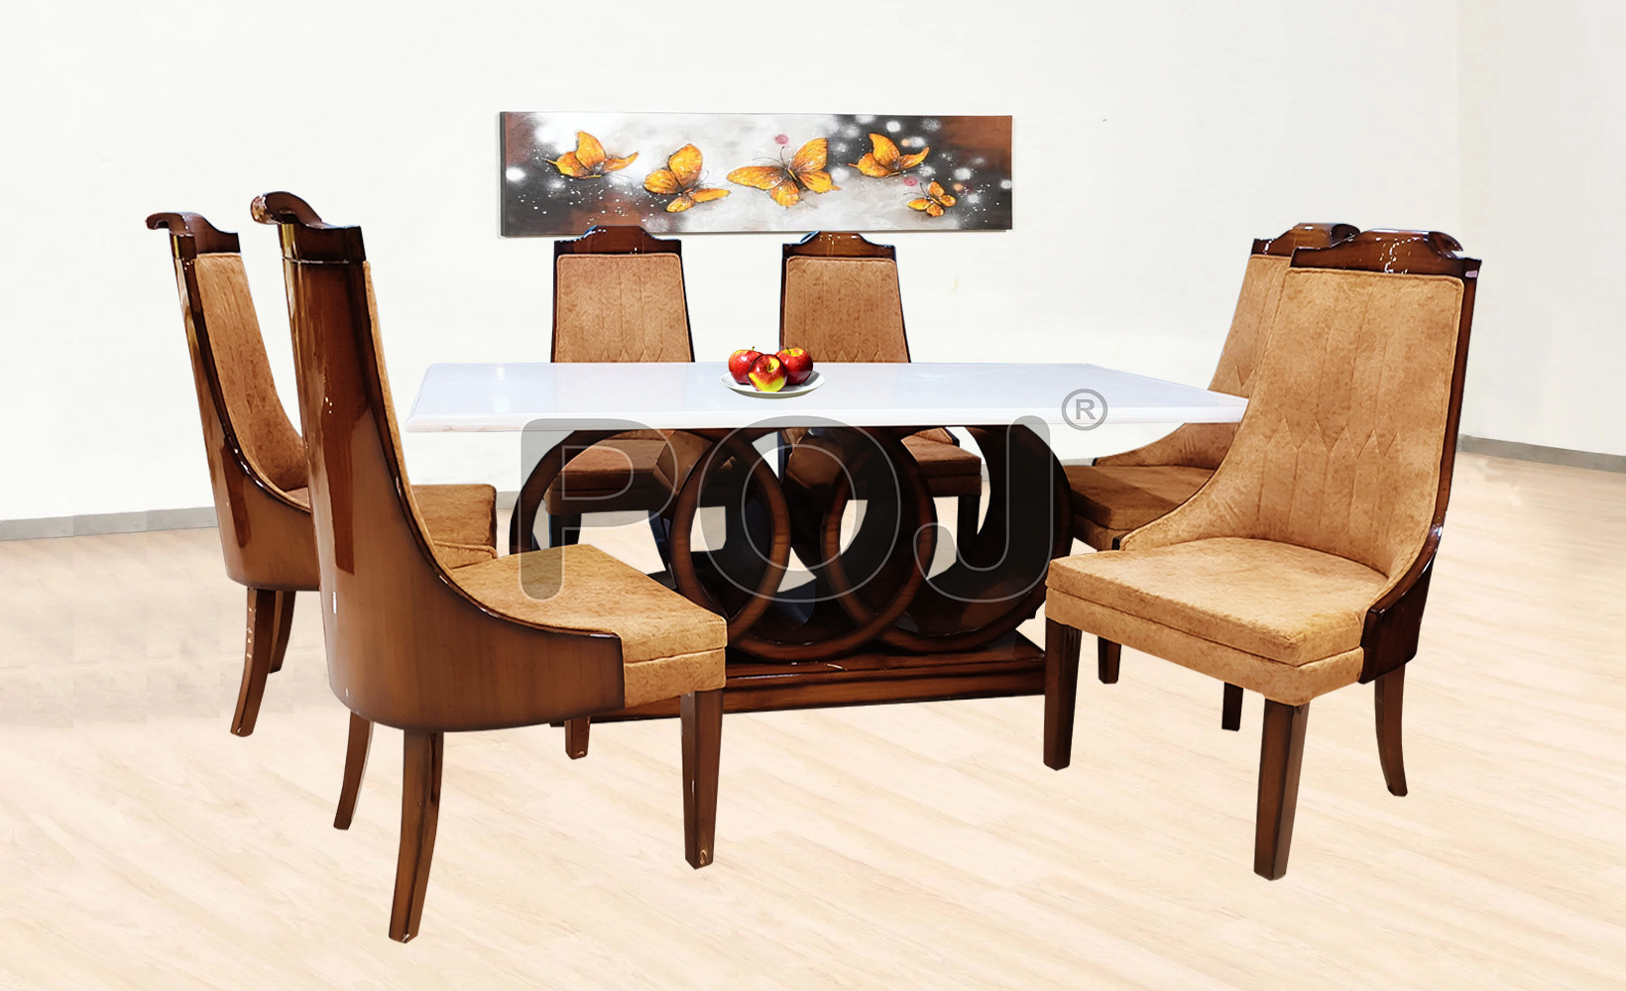


Thank you so much
  +91 993 905 5075
  M/S POJ FURNITURE BESIDE RANI SATI MANDIR, OPP HP PETROLPUMP, GOBINDPUR ROAD, PO- K G ASHRAM, DHANBAD Jharkhand - 828109
  https://www.pojfurniture.com/our-showrooms/bhubaneswar1

