Slide 1


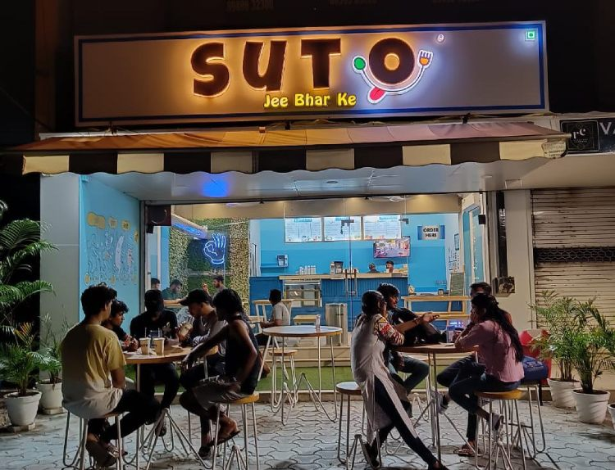


BEST COFFEE CHAINS IN INDIA
Start Your Own Coffee Business with a Profitable Café Model.
https://sutocafe.com/franchise/
www.sutocafe.com

Slide 2

Growing Coffee Culture
In India
  The demand for Best Coffee Chains in India is growing rapidly
  Cafés have become popular spaces for meetings, work, and social interaction
  Rising interest in Coffee Franchise in India opportunities
  Entrepreneurs are investing in low investment café businesses

Slide 3
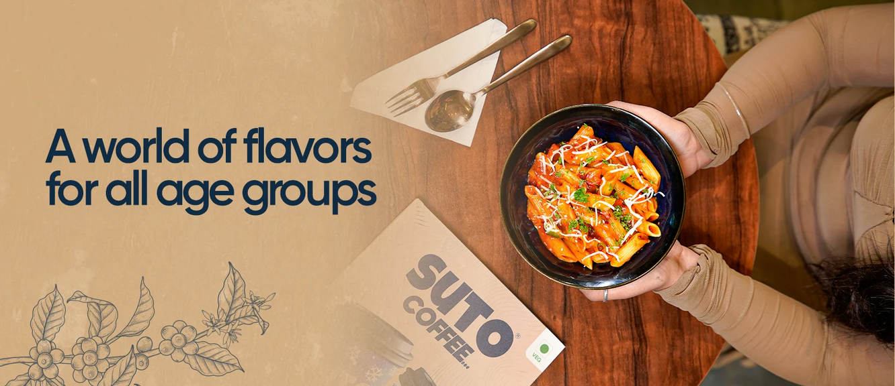
Top Coffee Chains
In India
  The Best Coffee Chains in India include both global and Indian brands
  Popular brands: Starbucks, Café Coffee Day (CCD), Barista, Costa Coffee
  Emerging brands: Blue Tokai, Third Wave Coffee
  These brands showcase the success of the coffee franchise business in India

Slide 4
Why Choose Sutocafe
Franchise?
  Recognized as one of the Best Coffee Shop Franchise in India
  Affordable and low investment café franchise model
  Complete support: setup, training, and marketing
  High ROI with a scalable and profitable business model
Start Your Coffee Business Today
https://sutocafe.com/franchise/

Slide 5
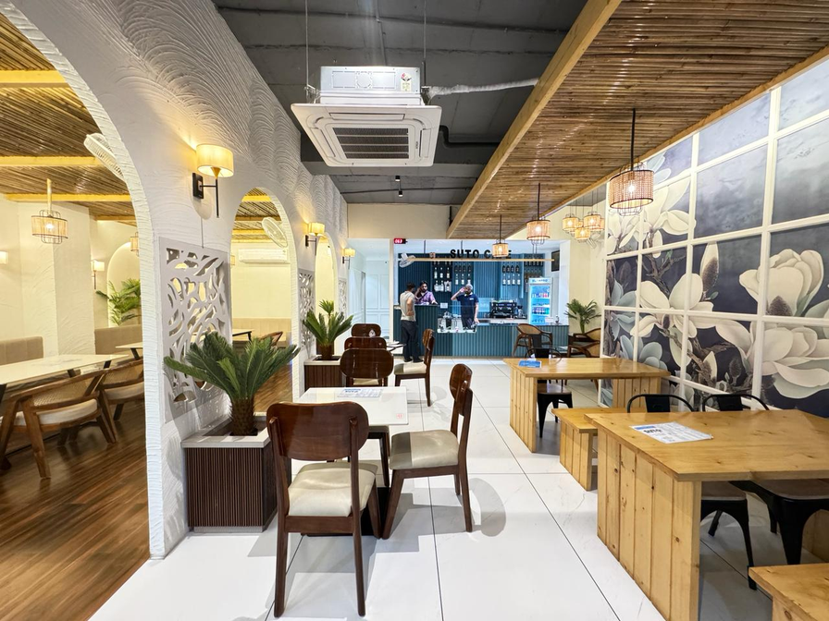
Get In Touch
  Address :- SutoCafe Global private limited Office No. 306,Satguru Parinay ,AB Road,Near Pakiza showroom Opposite C-21 Mall , Scheme 54 PU4 Indore, Madhya Pradesh 452011
  Website :- https://sutocafe.com/
  E-mail :- franchise@sutocafe.com
  Contact US :- +91 7880128851

