Slide 1


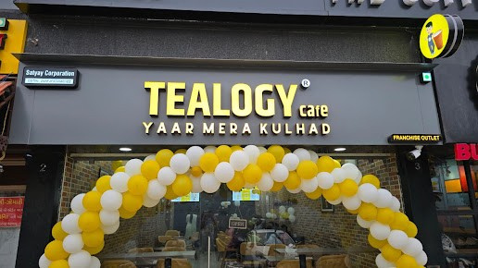

AFFORDABLE CAFE FRANCHISE
Looking for an affordable cafe franchise in India? Tealogy offers a cost-effective way to enter the café business with a modern tea concept and growing customer demand.
  Low investment business opportunity
  Fast-growing tea & café market
  Ideal for new entrepreneurs
  Simple and easy-to-manage operations
  Strong demand in urban & semi-urban areas

Slide 2
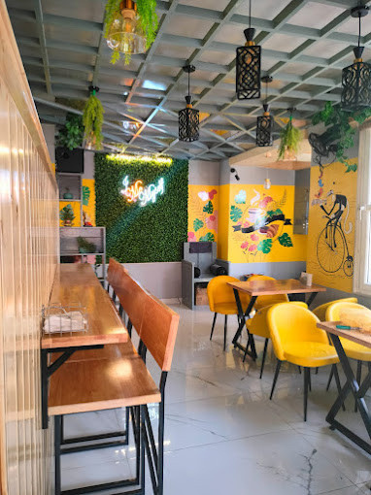

WHY TEALOGY IS AN AFFORDABLE CHOICE?
Tealogy is designed to provide maximum returns with minimal investment, making it one of the best affordable cafe franchise options.
  Budget-friendly franchise plans
  Low operational and maintenance costs
  High profit margins on beverages
  Complete training and support
  Ready-to-use business model

Slide 3
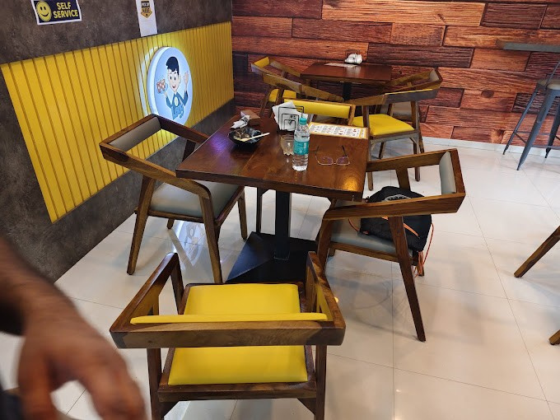
PROFIT & GROWTH POTENTIAL
With Tealogy, you get a scalable and profitable business model that ensures steady income and long-term growth.
  Quick return on investment (ROI)
  Daily cash flow business
  High customer repeat rate
  Opportunity to expand multiple outlets
  Growing popularity of chai cafés

Slide 4


CONTACT DETAILS
Address - 503-A/B, 5th Floor Princess Business Sky Park
Block no. 23,24 SCH No.54, PU-3 Commercial,
Opp C21, AB Rd, Indore, Madhya Pradesh 452001
Phone: +91-6269112500/ +91-6269120500
Email: business@tealogy.in

Slide 5
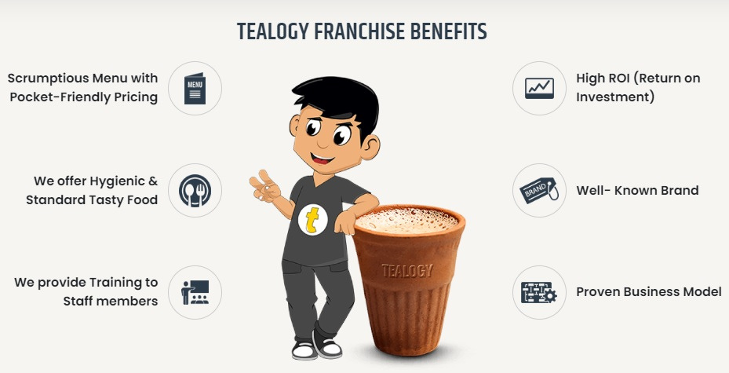
THANK YOU
To know more, please read this - https://tealogy.in/teacafe-franchise

