Slide 1





BEST CAFE FRANCHISE
Looking for the best cafe franchise in India? Tealogy offers a perfect blend of traditional chai and modern café culture. It is designed for entrepreneurs who want a profitable and easy-to-manage business.
  Fast-growing tea & café industry
  Trusted and emerging brand – Tealogy
  Perfect for beginners and investors
  Combines tradition with modern experience
  High demand across cities and towns

Slide 2


WHY CHOOSE TEALOGY CAFE FRANCHISE?
Tealogy stands out as one of the best cafe franchise options with its strong business model, unique menu, and complete support system.
  Wide range of tea & beverage options
  Affordable investment plans
  Complete training and setup support
  Attractive store design & branding
  High customer retention and repeat sales

Slide 3
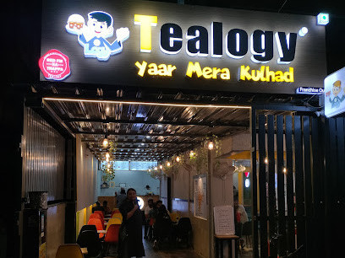
INVESTMENT, PROFIT & GROWTH OPPORTUNITY
Tealogy offers a low-investment, high-return opportunity with strong growth potential in India’s expanding café market.
  Low startup cost compared to restaurants
  High profit margins on beverages
  Quick return on investment (ROI)
  Daily cash flow business
  Expansion opportunities in multiple locations

Slide 4
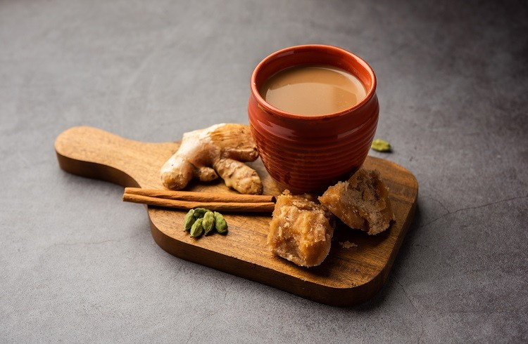
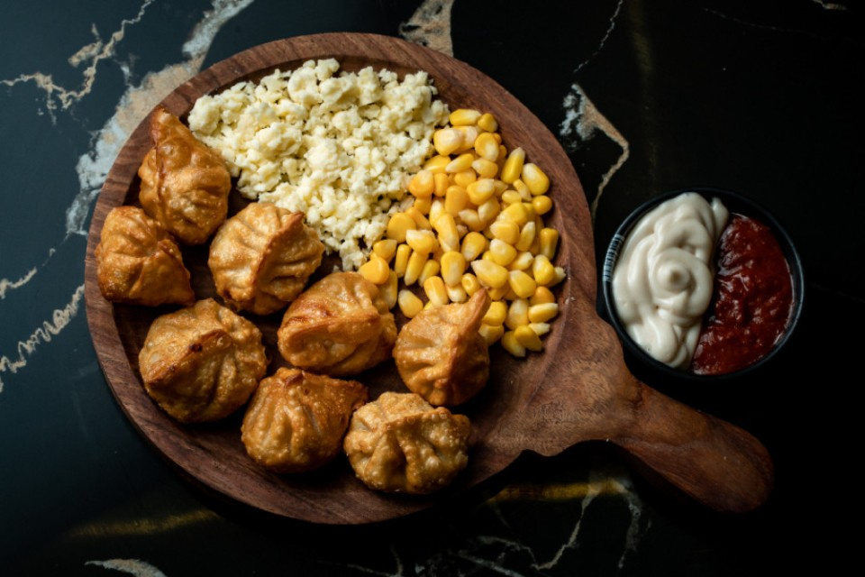
CONTACT DETAILS
Address - 503-A/B, 5th Floor Princess Business Sky Park
Block no. 23,24 SCH No.54, PU-3 Commercial,
Opp C21, AB Rd, Indore, Madhya Pradesh 452001
Phone: +91-6269112500/ +91-6269120500
Email: business@tealogy.in / https://tealogy.in/state/tea-cafe-franchise-delhi

Slide 5
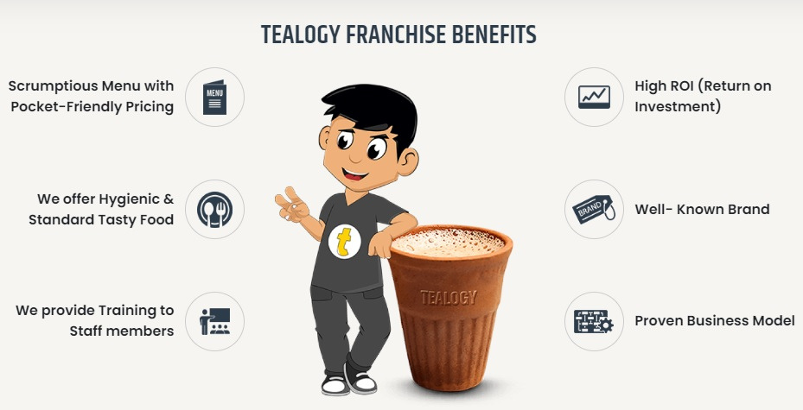
THANK YOU
To know more, please read this - https://tealogy.in/teacafe-franchise

