Slide 1

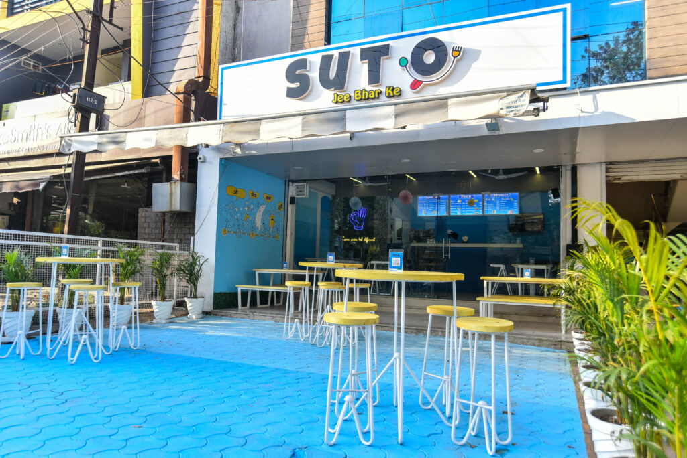

Best Coffee
Cafe Franchise | SutoCafe
  Start Your Own Coffee Business with Low Investment
  High ROI Coffee Cafe Franchise Opportunity
  Trusted & Fast-Growing Brand
  https://sutocafe.com/franchise/

Slide 2
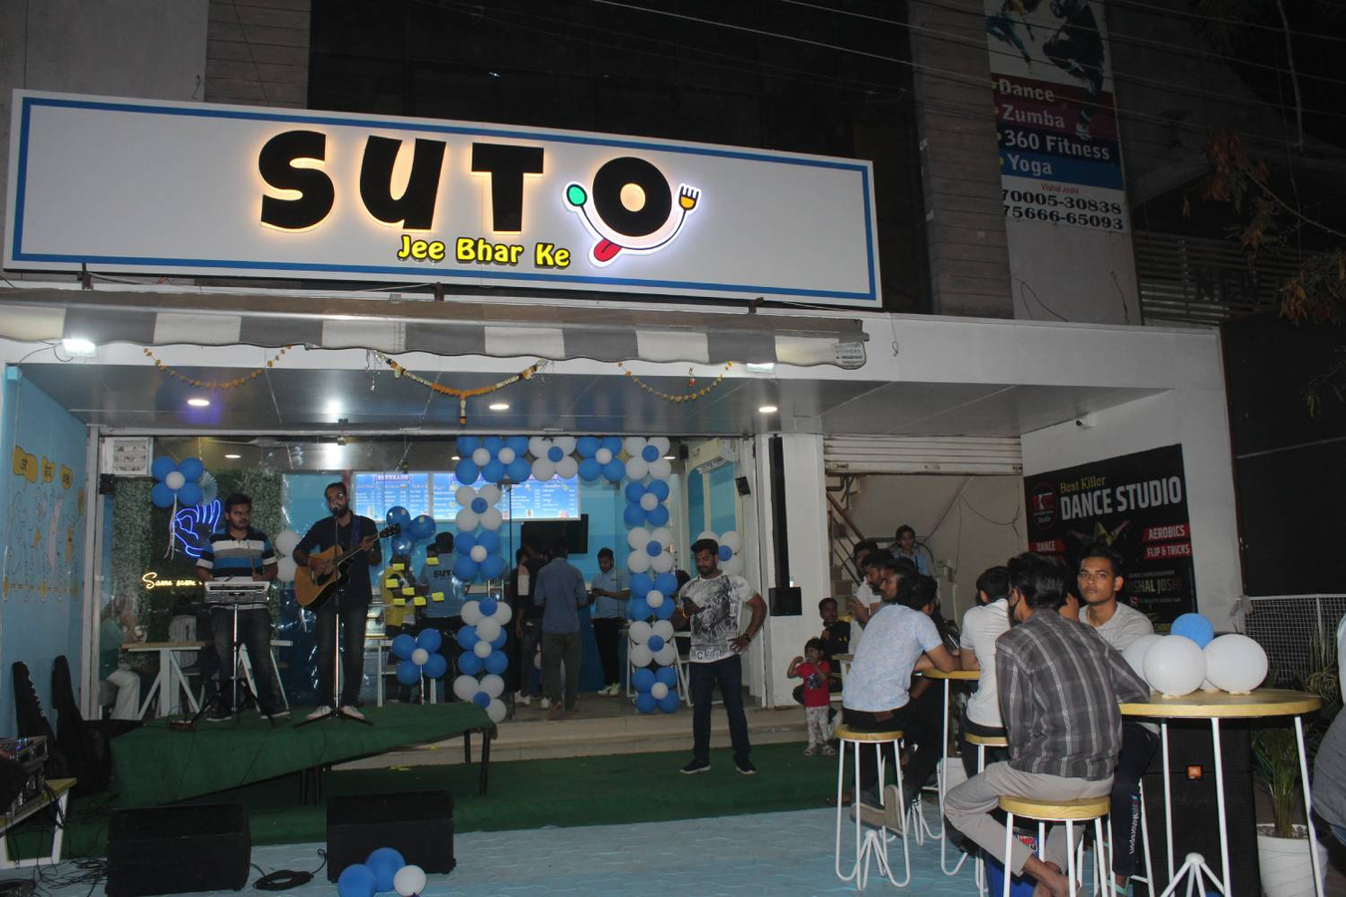
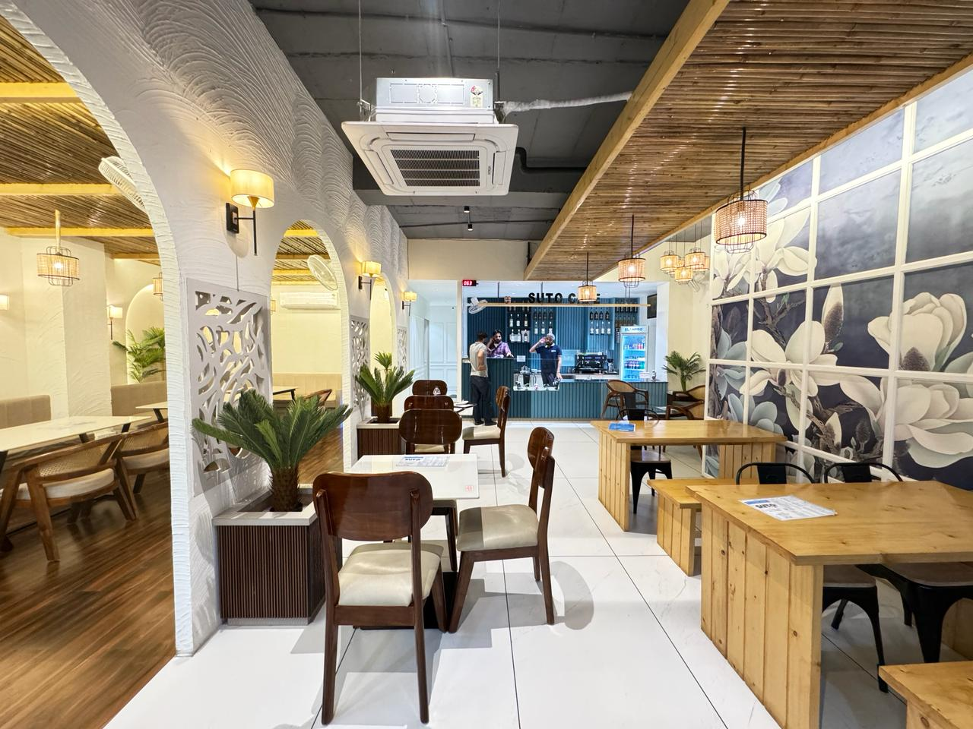
ABOUT US
  One of the best coffee cafe franchises in India
  Modern café concept with premium feel
  Wide menu: Coffee, shakes, snacks & more
  Strong youth appeal & growing demand
  Proven and scalable business model
Learn More: https://sutocafe.com/franchise/

Slide 3
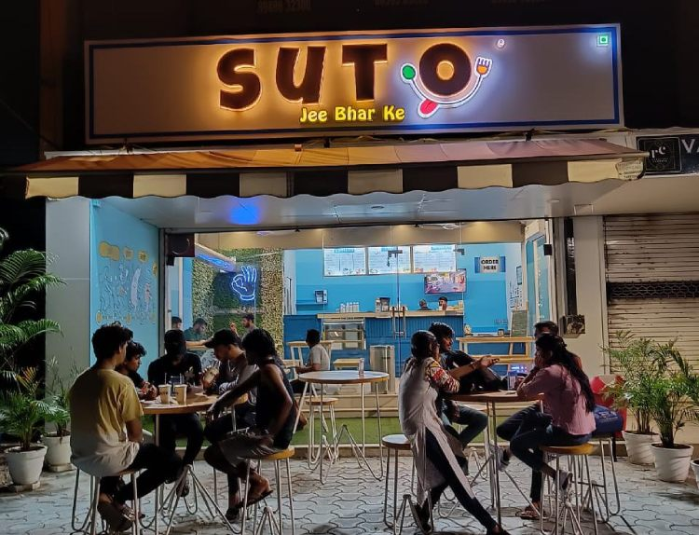
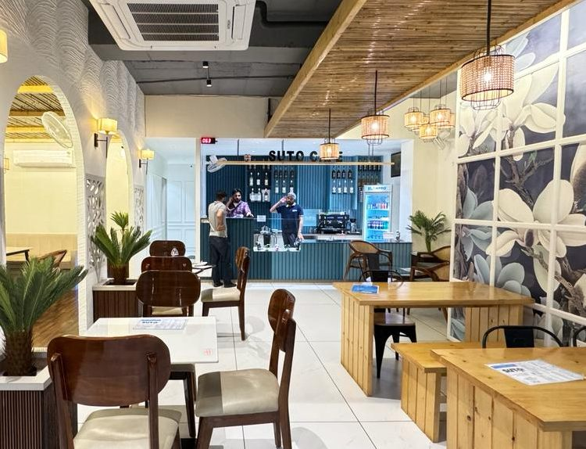
Start Your Coffee Business
  Ideal for entrepreneurs & investors
  Perfect locations: malls, colleges, high streets
  Fast setup with ongoing support
  Growing coffee culture in India
Get Started Today
https://sutocafe.com/franchise/

Slide 4
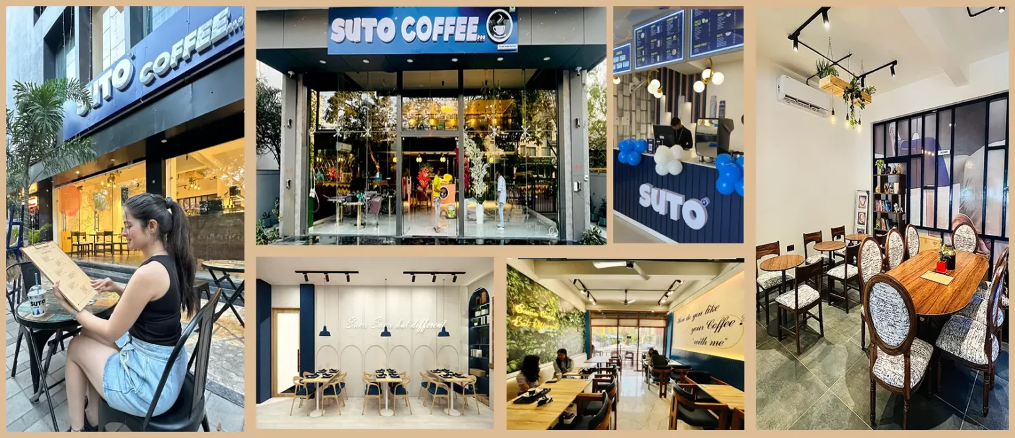
CONTACT US
Email
Phone
franchise@sutocafe.com
+91 7880128851
Website
Address
SutoCafe Global private limited Office No. 306,Satguru Parinay ,AB Road,Near Pakiza showroom Opposite C-21 Mall , Scheme 54 PU4 Indore, Madhya Pradesh 452011
https://sutocafe.com/

