Slide 1
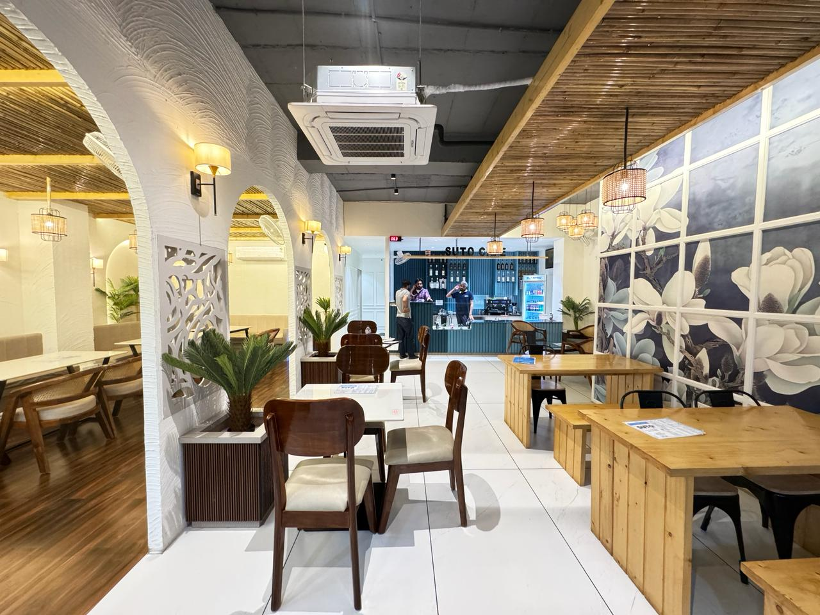

Best Cafe
Franchise
  Start Your Coffee Shop Business with Low Investment
  High ROI Cafe Franchise Opportunity
  Trusted & Growing Café Brand
  Visit: https://sutocafe.com/franchise/

Slide 2
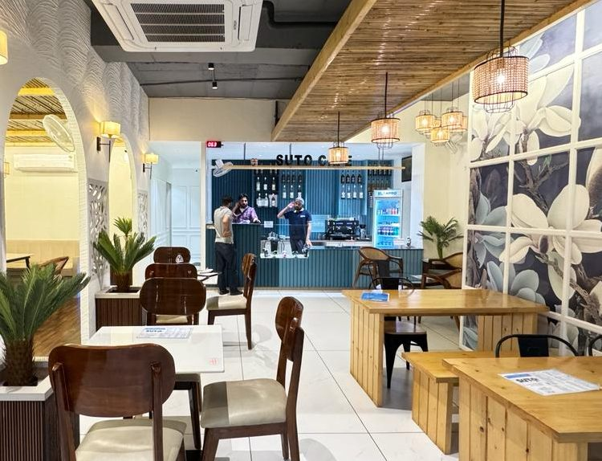
About SutoCafe
  Fast-growing café franchise brand
  Affordable café business model
  Wide menu: Coffee, beverages, snacks
  Youth-focused & high footfall concept
  Strong brand presence in India
Learn More: https://sutocafe.com/franchise/

Slide 3
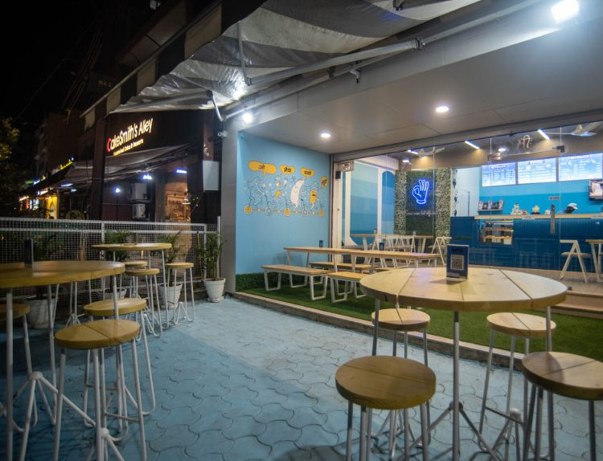
Start Your Cafe Business
  Perfect for entrepreneurs & investors
  Ideal locations: malls, colleges, high streets
  Quick setup & scalable model
  Growing coffee demand in India
Get Started Today:
https://sutocafe.com/franchise/

Slide 4
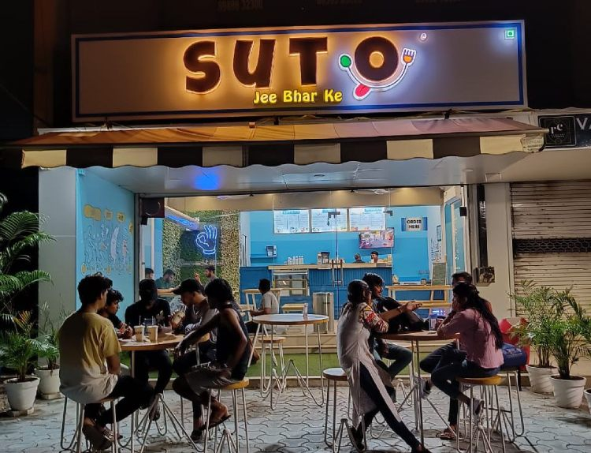

Thank You
Address :- SutoCafe Global private limited Office No. 306,Satguru Parinay ,AB Road,Near Pakiza showroom Opposite C-21 Mall , Scheme 54 PU4 Indore, Madhya Pradesh 452011
Website :- https://sutocafe.com/
E-mail :- franchise@sutocafe.com.
Contact US :- +91 7880128851

