Slide 1

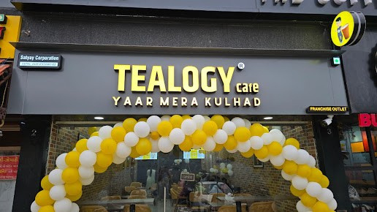
Cafe Business Model In Indore
Start Your Tea Journey with Tealogy
The Cafe Business Model In Indore is gaining strong popularity as the city embraces modern cafe culture. Tealogy brings a perfect blend of tradition and innovation with its premium tea offerings and authentic kulhad chai experience.
Key Highlights:
  Growing demand for tea cafes in Indore
  Unique kulhad chai concept
  Blend of traditional and modern experience
  Strong brand value of Tealogy
Visit - https://tealogy.in/city/tea-cafe-franchise-indore

Slide 2

Why Choose Tealogy
A Perfect Opportunity for Entrepreneurs
The Cafe Business Model In Indore by Tealogy is designed for those who want to enter the food and beverage industry with a trusted and successful concept.
Benefits:
  High demand for quality tea experiences
  Easy to operate business model
  Attractive and welcoming cafe ambiance
  Scalable and profitable opportunity
Visit - https://tealogy.in/city/tea-cafe-franchise-indore

Slide 3
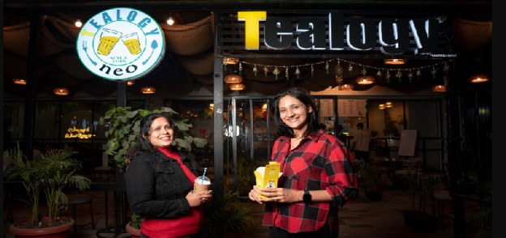
Features of Cafe Business
Complete Franchise Support
With the Cafe Business Model In Indore, Tealogy provides end-to-end support to ensure smooth operations and long-term success.
What You Get:
  Site selection and setup guidance
  Professional staff training
  Marketing and branding support
  Premium tea ingredients and supply
Visit - https://tealogy.in/city/tea-cafe-franchise-indore

Slide 4
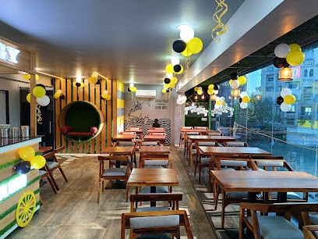
Grow with Tealogy
Build a Successful Tea Cafe Business
The Cafe Business Model In Indore offers a great chance to build a loyal customer base with high-quality tea and a memorable cafe experience.
Why It Works:
  Strong customer connection with kulhad chai
  Consistent quality and taste
  Increasing cafe culture in Indore
  Proven and reliable business model
Join Tealogy and explore the Cafe Business Model In Indore to start your successful tea cafe journey today!
Visit - https://tealogy.in/city/tea-cafe-franchise-indore

Slide 5

Thank You
CONTACT DETAILS
Address - 503-A/B, 5th Floor Princess Business Sky Park
Block no. 23,24 SCH No.54, PU-3 Commercial,
Opp C21, AB Rd, Indore, Madhya Pradesh 452001
Phone: +91-6269112500/ +91-6269120500
Email: business@tealogy.in / Visit - https://tealogy.in/city/tea-cafe-franchise-indore

