Slide 1

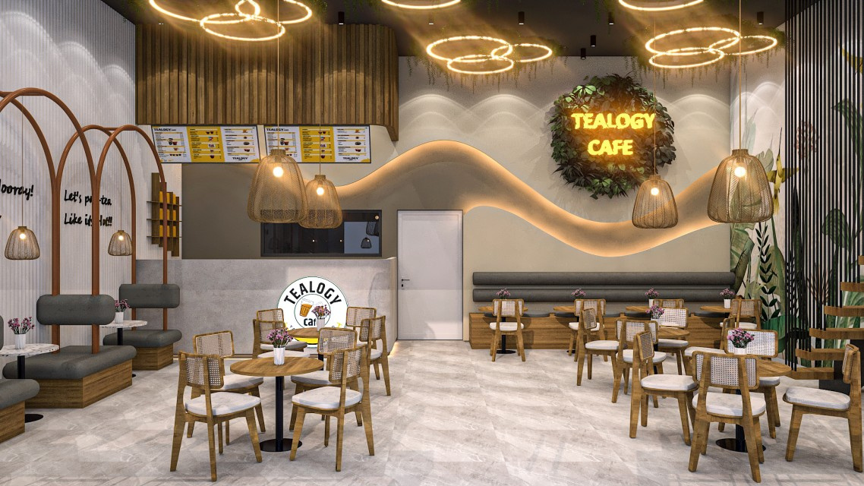
Cafe Franchise in Hyderabad
Start Your Tea Business with Tealogy
Hyderabad is one of the fastest-growing cities with a strong cafe culture. Tealogy offers a perfect opportunity to start your own cafe franchise with a unique kulhad chai concept that blends tradition with modern taste.
  Growing demand for tea cafes
  Strong urban customer base
  Unique kulhad chai concept
  Trusted and growing brand
Visit - https://tealogy.in/city/tea-cafe-franchise-hyderabad

Slide 2

Why Choose Tealogy?
A Brand Built on Quality & Innovation
Tealogy stands out for its premium tea offerings and authentic experience. Our focus is on delivering quality, consistency, and customer satisfaction.
What Makes Us Special:
  Authentic kulhad chai experience
  Wide variety of tea-based beverages
  High-quality ingredients
  Modern cafe setup with traditional touch
Visit - https://tealogy.in/city/tea-cafe-franchise-hyderabad

Slide 3
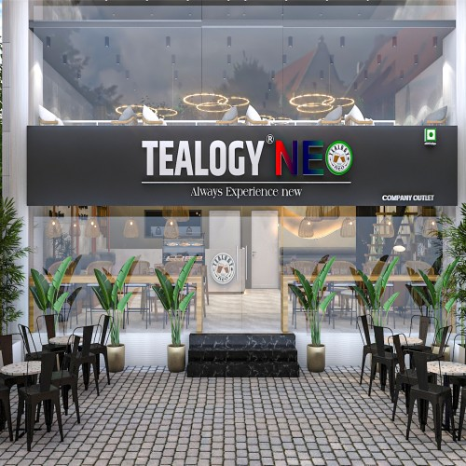
Franchise Benefits
Everything You Need to Succeed
With Tealogy, you don’t just get a brand—you get complete business support to help you grow successfully in Hyderabad’s competitive market.
Franchise Support Includes:
  Complete training & guidance
  Marketing & branding support
  Premium tea supply & equipment
  Proven business model
Visit - https://tealogy.in/city/tea-cafe-franchise-hyderabad

Slide 4

Opportunity in Hyderabad
Tap into a Growing Market
Hyderabad’s tea-loving audience and fast-paced lifestyle make it an ideal location for a profitable cafe franchise business.
Why Hyderabad?
  Large youth & working population
  High demand for cafe culture
  Strong repeat customer potential
  Excellent growth opportunities
Start your journey with Tealogy today and become part of a successful tea franchise network!
Visit - https://tealogy.in/city/tea-cafe-franchise-hyderabad

Slide 5

Thank You
CONTACT DETAILS
Address - 503-A/B, 5th Floor Princess Business Sky Park
Block no. 23,24 SCH No.54, PU-3 Commercial,
Opp C21, AB Rd, Indore, Madhya Pradesh 452001
Phone: +91-6269112500/ +91-6269120500
Email: business@tealogy.in / Visit - https://tealogy.in/city/tea-cafe-franchise-hyderabad

