Slide 1
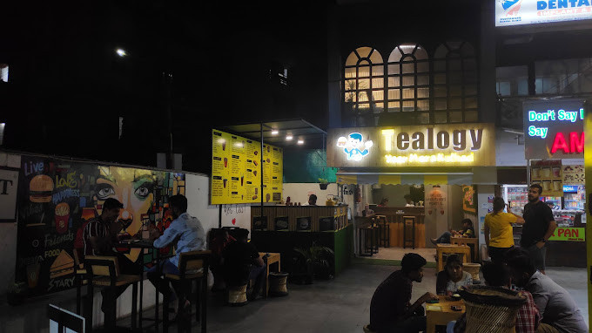


Benefits Of Owning A Cafe Franchise
The café industry is growing rapidly around the world. People love spending time in cafés while enjoying coffee, tea, and snacks. Because of this growing demand, many entrepreneurs are choosing to invest in a café business. One of the best ways to start this journey is by owning a café franchise. The Benefits Of Owning A Cafe Franchise make it an attractive option for both new and experienced business owners.
Starting a café from scratch can be challenging. It requires planning, branding, marketing, and operational experience. However, a franchise business provides a ready system that helps entrepreneurs start their business more easily. With the support of an established brand, the chances of success become much higher.
https://tealogy.in/

Slide 2

Established Brand Recognition
One of the biggest Benefits Of Owning A Cafe Franchise is brand recognition. When you start a franchise, you are using a brand that people already know and trust. Customers feel comfortable visiting a café that already has a good reputation.
Because of this trust, franchise cafés can attract customers faster compared to new independent cafés. This helps the business grow quickly and build a loyal customer base.

Slide 3
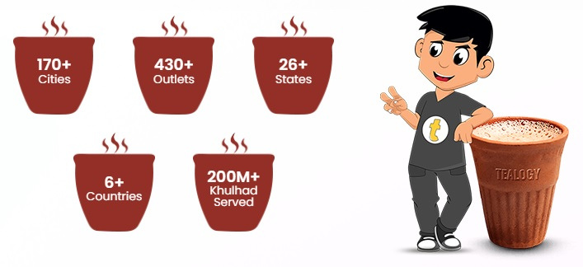


Contact us
+91 6269116000 / 6269120500
business@tealogy.in / franchise@tealogy.in
503-A/B, 5th Floor Princess Business Sky Park, Block no. 23,24
AB Rd, Indore, Madhya Pradesh 452001
https://tealogy.in/
https://tealogy.in/

Slide 4

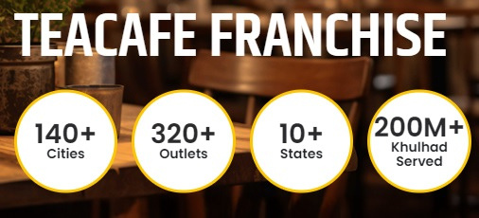
Thank You
https://tealogy.in/

