Slide 1



Chai Franchise in India
India is one of the largest tea-consuming countries in the world. Tea is not just a drink but a daily habit for millions of people. Because of this huge demand, starting a Chai Franchise in India has become a profitable business opportunity.
A chai franchise allows entrepreneurs to start their own tea café with an established brand. It provides a ready business model, brand recognition, and operational support. As a result, many young entrepreneurs are choosing tea café franchises as their first business.
https://tealogy.in/

Slide 2

Growing Demand for Chai Cafés
The tea café industry in India is growing rapidly. Today, people prefer modern tea cafés instead of traditional roadside tea stalls. These cafés offer a comfortable place where customers can relax and enjoy different tea flavors.
Chai Franchise in India combines traditional tea culture with a modern café experience. Popular menu items include kulhad chai, masala chai, ginger tea, and flavored tea blends. Because of this variety, chai cafés attract students, office workers, and families.

Slide 3
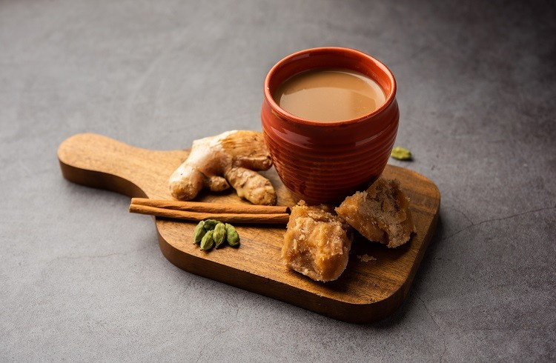


Contact us
+91 6269116000 / 6269120500
business@tealogy.in / franchise@tealogy.in
503-A/B, 5th Floor Princess Business Sky Park, Block no. 23,24
AB Rd, Indore, Madhya Pradesh 452001
https://tealogy.in/
https://tealogy.in/

Slide 4

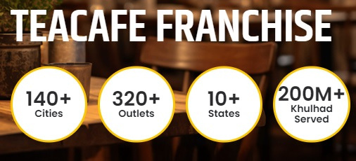
Thank You
https://tealogy.in/

