Slide 1



BEST RESORTS IN
MANALI

Slide 2
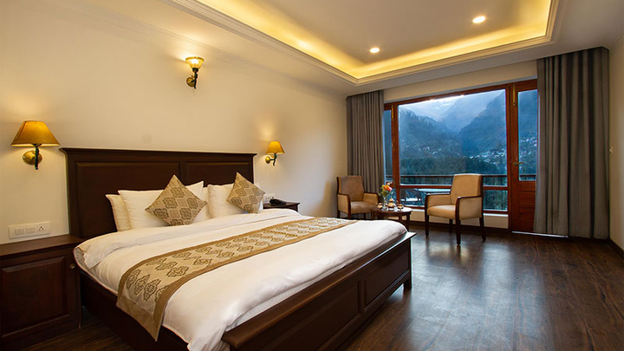

INTRODUCTION
Best Resorts in Manali
Discover comfort, luxury, and breathtaking Himalayan beauty at Aloka Resort Manali. Recognized among the Best Resorts in Manali, it offers a peaceful mountain retreat with elegant rooms, modern amenities, and warm hospitality for travelers seeking a memorable stay.
https://alokaresortmanali.com/

Slide 3
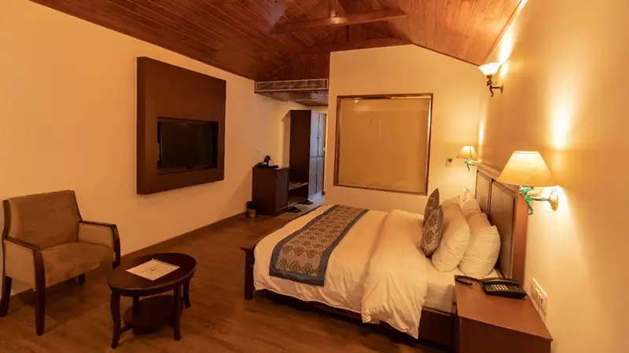

ABOUT ALOKA RESORT MANALI
Aloka Resort Manali is one of the Best Resorts in Manali, known for its serene surroundings, stylish accommodations, and exceptional service. Surrounded by the stunning landscapes of Manali, the resort provides the perfect setting for relaxation and unforgettable travel experiences.

Slide 4

LUXURY STAY & FACILITIES
As one of the Best Resorts in Manali, Aloka Resort Manali offers well-appointed rooms, beautiful mountain views, delicious dining options, and excellent guest services. Whether you are planning a honeymoon, family vacation, or leisure trip, the resort ensures comfort and luxury.

Slide 5
THANK YOU
Perfect Getaway in Manali
If you are searching for the Best Resorts in Manali, Aloka Resort Manali is an ideal choice. Experience peaceful surroundings, scenic Himalayan views, and outstanding hospitality that make your stay in Manali truly special.
Visit: https://alokaresortmanali.com/
Contact Information
Address :- Chadyari Tehsil Manali Distt Kullu H.P 175131 INDIA
Phone No. +91 98160-76122
E-mail us :- alokaresortmanali@gmail.com
Website :- www.alokaresortmanali.com

