Slide 1

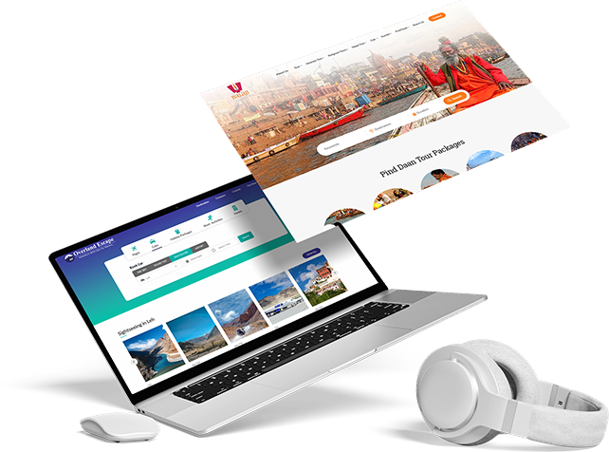
BEST TRAVEL WEBSITE DEVELOPMENT COMPANY
Travipro – Best Travel Website Development Company
  Travipro is a trusted name in travel website development in India.
  We create modern, responsive, and user-friendly travel websites.
  Our solutions help travel agencies grow their online presence.
  Travipro delivers secure, scalable, and high-performance travel portals
Contact information
Address :- B-112, Sector-64 Noida - 201301
EMail :- info@travipro.com
Get In Touch :- +91 9560 433 3182
Website :- https://www.travipro.com

Slide 2
ADVANCED TRAVEL WEBSITE DEVELOPMENT SOLUTIONS
  Custom travel website design with advanced booking features.
  API integration for flights, hotels, buses, and holiday packages.
  Mobile-friendly travel web development for better user experience.
  Secure payment gateway integration for safe transactions.
  Travipro ensures fast, reliable, and efficient website performance.
Contact information
Address :- B-112, Sector-64 Noida - 201301
EMail :- info@travipro.com
Get In Touch :- +91 9560 433 3182
Website :- https://www.travipro.com

Slide 3
GROW YOUR TRAVEL BUSINESS WITH TRAVIPRO
  Professional travel website development tailored to your needs.
  Powerful features for travel agencies, tour operators, and startups.
  Build a strong online presence with Travipro travel website solutions.
  Start your journey with the best travel website development company.
URL: https://www.travipro.com/travel-website-development.html
Contact information
Address :- B-112, Sector-64 Noida - 201301
EMail :- info@travipro.com
Get In Touch :- +91 9560 433 3182
Website :- https://www.travipro.com

