Slide 1



Best Resort in Manali
Presented By: Aloka Resort

Slide 2

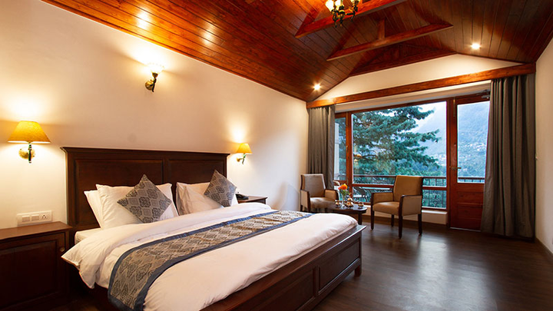
Introduction
Aloka Resort Manali is a premium mountain retreat known as the Best Resort in Manali, offering a perfect blend of luxury, comfort, and natural beauty. Nestled in the serene Himalayas, it promises a peaceful and memorable stay experience.

Slide 3

Why Choose Aloka Resort?
  Elegant rooms with scenic mountain views
  Modern amenities and premium hospitality
  Ideal for honeymooners, families & leisure travelers
  Peaceful location surrounded by nature
  Trusted luxury stay in Manali

Slide 4
Book Your Stay
Plan Your Perfect Mountain Escape
Choose Aloka Resort Manali, the Best Resort in Manali, for an unforgettable holiday filled with luxury and tranquility.
Book Now: https://alokaresortmanali.com/
Contact Information
Address :- Chadyari Tehsil Manali Distt Kullu H.P 175131 INDIA
Phone No. +91 98160-76122
E-mail us :- alokaresortmanali@gmail.com
Website :- www.alokaresortmanali.com

