Slide 1


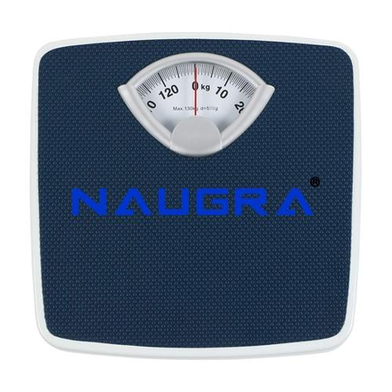
Medical Height &
Weight Scales Manufacturers
Presented By: NaugraMedicals

Slide 2


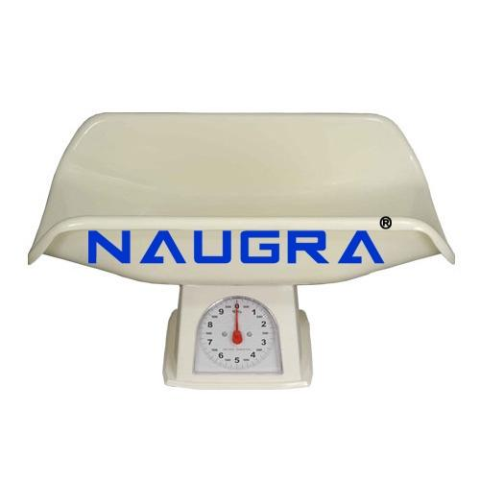
Introduction
NaugraMedicals is a trusted global brand delivering precision-engineered medical measurement solutions for healthcare facilities. As a leading provider of height and weight measurement equipment, NaugraMedicals focuses on accuracy, durability, and compliance with international medical standards. Our products support hospitals, clinics, and diagnostic centers worldwide.

Slide 3
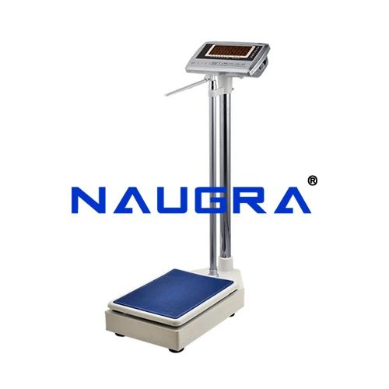
Product Range &
Applications
At NaugraMedicals, we offer a wide range of height and weight scales designed for clinical efficiency and patient comfort. These medical scales are ideal for hospitals, laboratories, and wellness centers, ensuring consistent and reliable measurement results. Explore our advanced solutions at
https://www.naugramedical.com/height-weight-scales

Slide 4
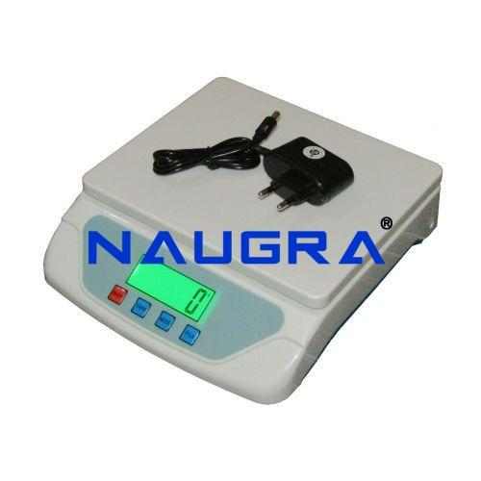
Why Choose NaugraMedicals
Choose NaugraMedicals for dependable measurement solutions backed by industry expertise and global trust. With a strong commitment to innovation and customer satisfaction, we support healthcare professionals with premium-grade equipment.
Learn more about our medical measurement solutions at
https://www.naugramedical.com/height-weight-scales

Slide 5
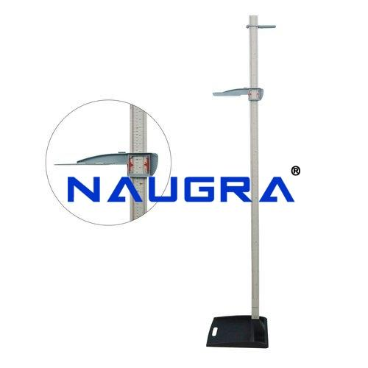
Contact Us
Address :- 6148/6, Guru Nanak Marg, Ambala Cantt, Haryana, India
Phone No :- +91-9896600003
Website :- www.naugramedical.com

