Slide 1

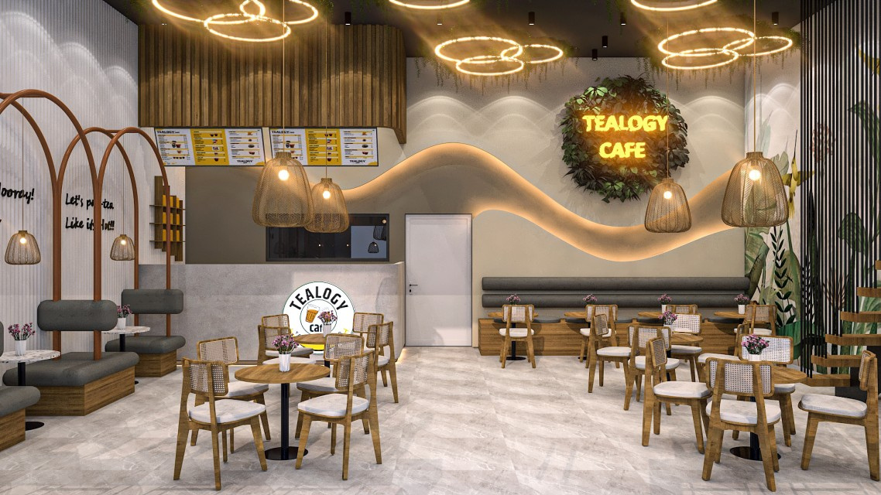
Tealogy
Affordable Cafe Franchise
Visit - https://tealogy.in/teacafe-franchise

Slide 2
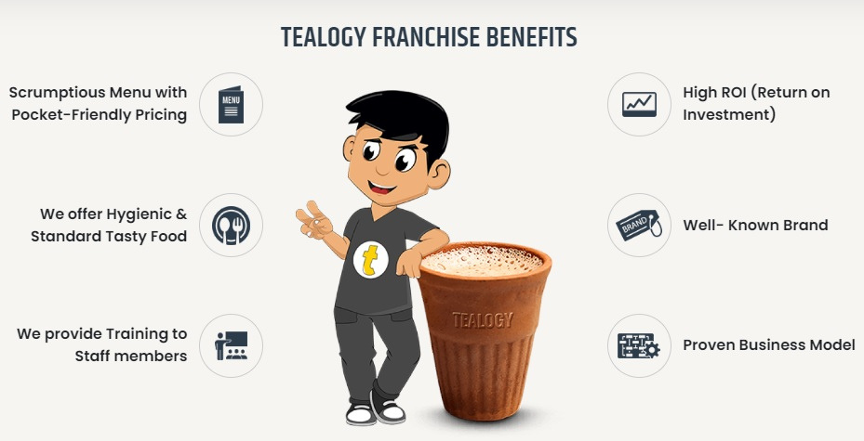
Tealogy tea cafe franchise offers a proven, affordable business model with support, training, diverse tea-and-snack menu, and strong brand presence for entrepreneurs seeking high ROI in the growing Indian cafe industry.

Slide 3
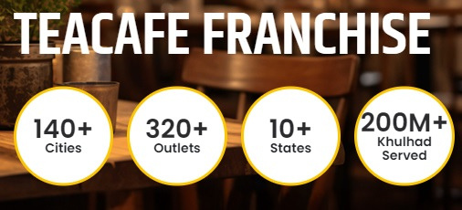
Visit - https://tealogy.in/teacafe-franchise

Slide 4
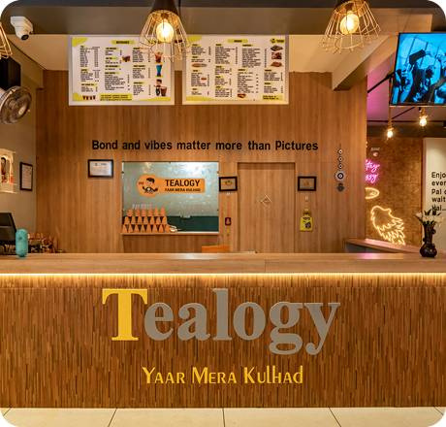
Thank You
Visit - https://tealogy.in/teacafe-franchise

