Slide 1



LUXURY RESORTS IN MANALI

Slide 2
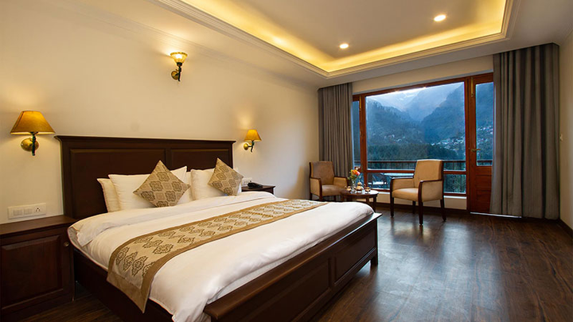

INTRODUCTION
AlokaResort – Premium Mountain Luxury
AlokaResort offers a serene escape amidst the snow-capped peaks of Manali. Experience refined rooms, modern amenities, and warm hospitality at AlokaResort. Perfect for families, couples, and leisure travelers seeking comfort and style.

Slide 3
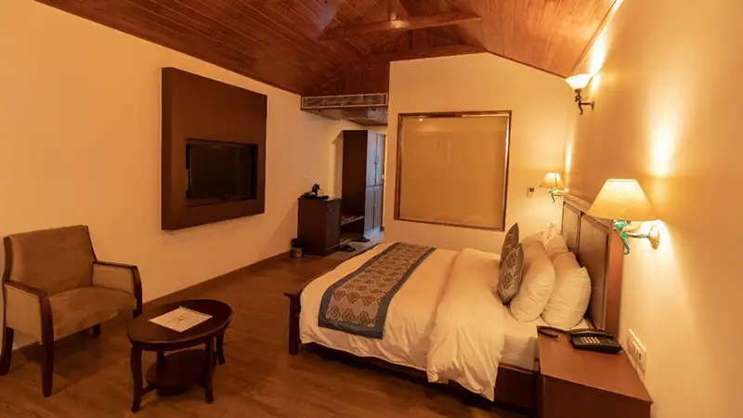

EXPERIENCES & AMENITIES
Relax in elegantly designed rooms, enjoy fine dining, and rejuvenate at wellness spaces. AlokaResort provides adventure activities, cozy evenings, and mountain-facing sit-outs. Personalized service ensures a memorable stay in one of the most sought-after luxury resorts in Manali.

Slide 4

WHY CHOOSE ALOKARESORT
AlokaResort delivers unmatched luxury, personalized service, and peaceful surroundings. Indulge in the perfect combination of nature, comfort, and style at this premier destination. Visit https://alokaresortmanali.com/ to plan your next escape to the Himalayas.

Slide 5
THANK YOU
Contact Information
Address :- Chadyari Tehsil Manali Distt Kullu H.P 175131 INDIA
Phone No. +91 98160-76122
E-mail us :- alokaresortmanali@gmail.com
Website :- www.alokaresortmanali.com

