Slide 1



Top Resort in Manali
@AlokaResort

Slide 2

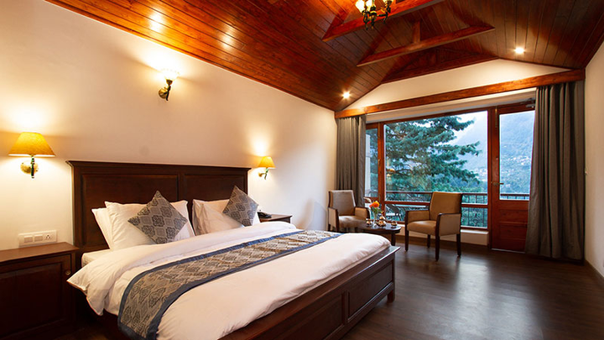
ABOUT
  Discover the top resort in Manali, Aloka Resort, your gateway to a luxurious Himalayan experience.
  Nestled amidst the pristine mountains, surrounded by lush greenery and fresh air.
  Designed for comfort, elegance, and a peaceful getaway from city life.
  Book your stay now: https://alokaresortmanali.com

Slide 3

Key Features & Amenities
  Scenic Views: Enjoy breathtaking views of snow-capped mountains and lush valleys.
  Recreational Facilities: Indoor games, spa, and outdoor activities for adventure lovers.
  Dining Experience: Multi-cuisine restaurant serving local and international dishes.
  Comfort & Convenience: Free Wi-Fi, 24/7 room service, and secure parking.

Slide 4
Book Your Stay
  Experience an unforgettable Himalayan escape at Aloka Resort, where luxury meets nature.
  Plan your trip with easy booking and excellent hospitality.
  Reserve your stay today: https://alokaresortmanali.com
  Make memories that last a lifetime in the heart of Manali.
Address :- Chadyari Tehsil Manali Distt Kullu H.P 175131 INDIA
Phone No. +91 98160-76122
E-mail us :- alokaresortmanali@gmail.com
Website :- www.alokaresortmanali.com

