Slide 1


TRAVEL PORTAL SOFTWARE SOLUTIONS
Presented By , Travipro

Slide 2
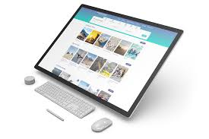
TRAVIPRO
Travipro delivers advanced, scalable travel technology designed for modern travel businesses. Our branded travel platform empowers agencies, tour operators, and startups with seamless booking, automation, and real-time inventory management for faster growth.

Slide 3
POWERFUL TRAVEL PORTAL DEVELOPMENT
With Travipro’s innovative travel portal development services, businesses can manage flights, hotels, tours, and APIs through a single, user-friendly dashboard. Built for performance, security, and customization to meet evolving travel market demands.
https://www.travipro.com/travel-portal-development.html

Slide 4
FOR MORE INFORMATION
Address :- B-112, Sector-64 Noida - 201301
EMail :- info@travipro.com
Get In Touch :- +91 9560 433 3182
Website :- https://www.travipro.com

