Slide 1

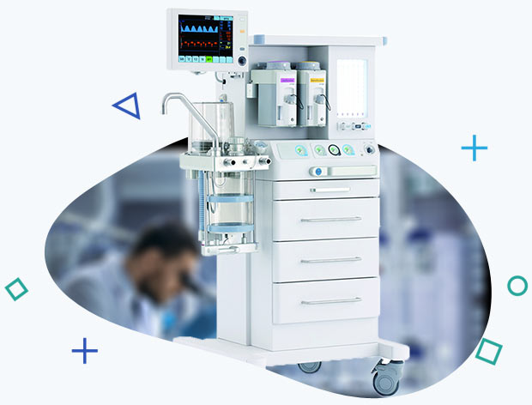
MEDICAL LAB EQUIPMENTS MANUFACTURERS
Presented By ,
NaugraMedicals
Contact Information
Address :- 6148/6, Guru Nanak Marg, Ambala Cantt, Haryana, India
Phone No :- +91-9896600003
Website :- www.naugramedical.com

Slide 2

ABOUT
Medical Lab Equipments Manufacturers play a vital role in advancing modern diagnostics. NaugraMedicals delivers precision-built laboratory instruments designed to enhance testing accuracy, workflow efficiency, and long-term reliability across hospitals, clinics, and research facilities worldwide.
Contact Information
Address :- 6148/6, Guru Nanak Marg, Ambala Cantt, Haryana, India
Phone No :- +91-9896600003
Website :- www.naugramedical.com

Slide 3
COMPREHENSIVE PRODUCT RANGE
NaugraMedicals offers a wide range of laboratory solutions, including analyzers, microscopes, centrifuges, incubators, and diagnostic devices. Each product is engineered to deliver consistent precision, supporting laboratories in achieving reliable test outcomes and meeting global healthcare demands.
Contact Information
Address :- 6148/6, Guru Nanak Marg, Ambala Cantt, Haryana, India
Phone No :- +91-9896600003
Website :- www.naugramedical.com

