Slide 1



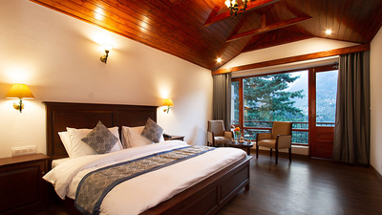
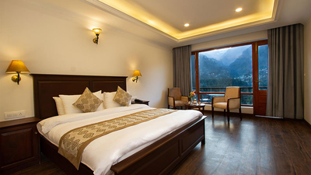
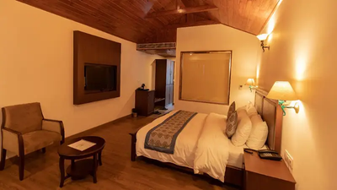







BEST
LUXURY HOTEL
Luxury Resorts in Manali
Aloka Resort stands among the finest luxury resorts in Manali, offering scenic Himalayan views, premium amenities and warm hospitality.
OUR FACILITIES
spacious luxury rooms
outdoor adventure activities
Spa & Wellness Center
cozy café and lounge
Chadyari Tehsil Manali Distt Kullu H.P 175131 INDIA
CONTACT US
www.alokaresortmanali.com

Slide 2

Introduction
BEST
LUXURY HOTEL
Aloka Resort stands among the finest luxury resorts in Manali, offering scenic Himalayan views, premium amenities and warm hospitality. Its peaceful location, elegant rooms and nature-rich surroundings create the perfect blend of comfort, relaxation and mountain charm.
Manali offers the perfect mix of natural beauty, peace and premium hospitality. Luxury resorts here blend modern comfort with breathtaking views, creating an unforgettable mountain getaway. Among these, Aloka Resort stands out for its serene ambience and elegant design.
Chadyari Tehsil Manali Distt Kullu H.P 175131 INDIA
CONTACT US
www.alokaresortmanali.com

Slide 3

Premium Amenities & Experiences
BEST
LUXURY HOTEL
At Aloka Resort, guests enjoy beautifully designed rooms, delicious dining, nature-facing balconies and relaxing outdoor spaces. The resort delivers a blend of comfort and tranquillity, ensuring a memorable stay surrounded by mountains and fresh alpine air.
Chadyari Tehsil Manali Distt Kullu H.P 175131 INDIA
CONTACT US
www.alokaresortmanali.com

