Slide 1


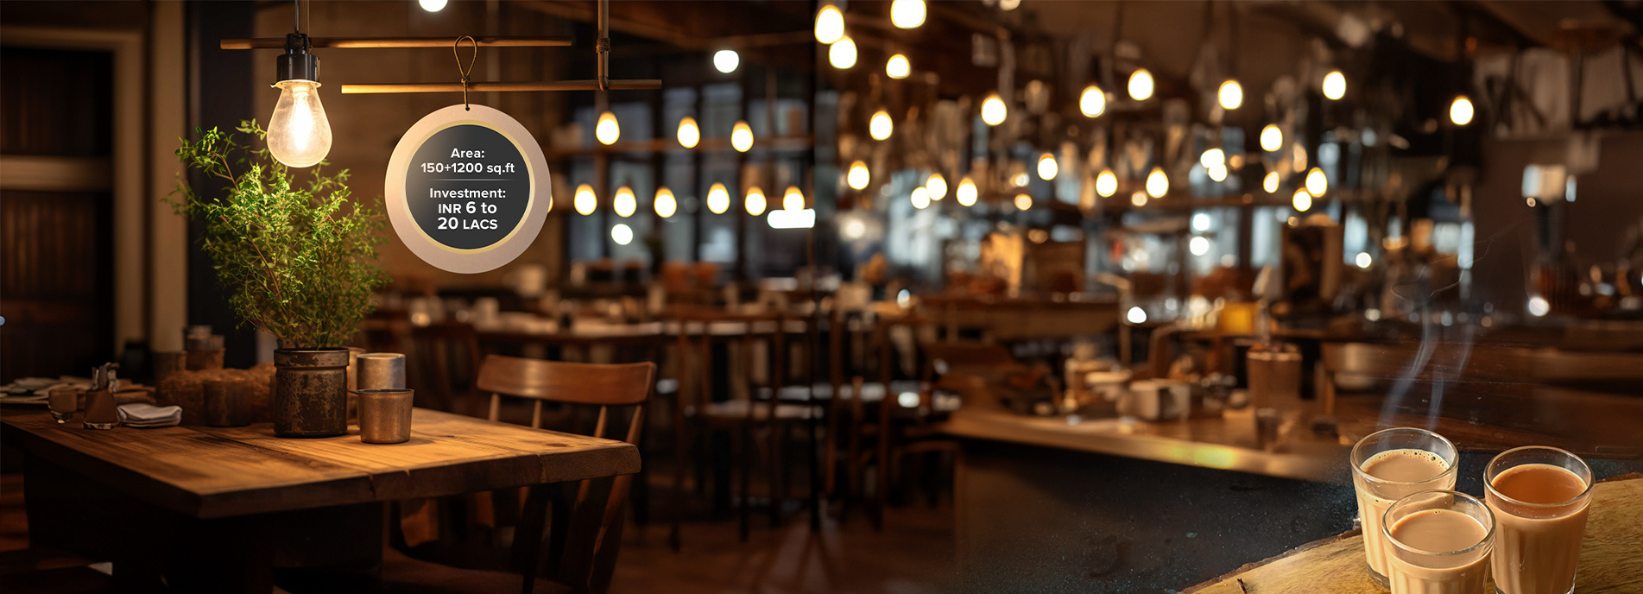


BENEFITS OF OWNING A CAFE FRANCHISE
To know more, please read this - https://tealogy.in/blog/choosing-between-cafe-franchise-and-independent-coffee-shop-and-why-cafe-franchise-is-the-smarter-choice

Slide 2

BENEFITS OF OWNING A CAFE FRANCHISE
Instant Brand Identity & Customer Trust
A franchise comes with an established brand name, trusted reputation and loyal customer base—so customers are more likely to visit your café even at a new location.
Lower Risk thanks to a Proven Business Model
Franchise models are baked in with tested systems for store layout, inventory, marketing, and operations, reducing guesswork and minimizing the risk of costly mistakes.
Ongoing Training and Operational Support
As a franchisee, you receive guidance and support in running the café — from staff training to supply-chain management and marketing — making everyday operations smoother.
Faster Return on Investment & Easier Financing
Because of brand recognition and streamlined operations, you’re likely to attract customers quickly and reach profitability faster. Also, banks and lenders tend to be more comfortable financing franchises compared to brand-new independent shops.
Simplified Supply Chain & Consistent Menu Quality
A café franchise already has suppliers and standardized recipes in place, ensuring consistent product quality, easier sourcing, and stable pricing — something harder to achieve on your own with an independent setup.

Slide 3
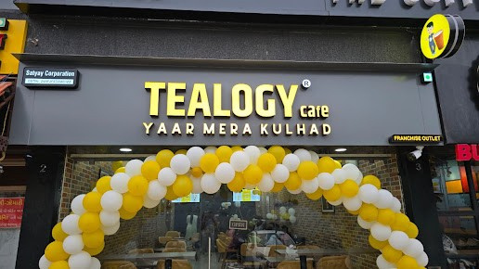
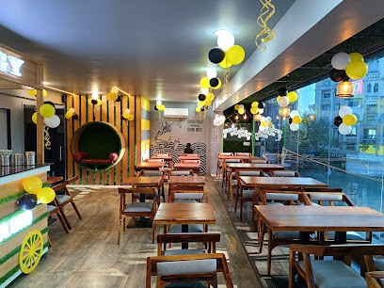
CONTACT DETAILS
Address - 503-A/B, 5th Floor Princess Business Sky Park
Block no. 23,24 SCH No.54, PU-3 Commercial,
Opp C21, AB Rd, Indore, Madhya Pradesh 452001
Phone: +91-6269112500/ +91-6269120500
Email: business@tealogy.in / franchise@tealogy.in

Slide 4
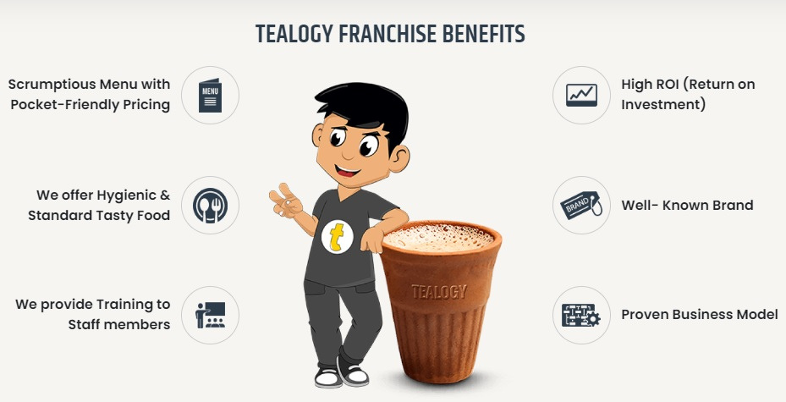
THANK YOU
To know more, please read this - https://tealogy.in/blog/choosing-between-cafe-franchise-and-independent-coffee-shop-and-why-cafe-franchise-is-the-smarter-choice

