Slide 1




Hospital Lab Equipments Manufacturers
Powering Modern Healthcare with Quality & Innovation

Slide 2

Introduction
Hospital laboratory equipment manufacturers play a vital role in supporting accurate diagnostics, efficient workflows, and reliable healthcare outcomes. NaugraMedicals delivers advanced, durable, and high-performance lab equipment tailored to hospital needs.
Visit ,
https://www.naugramedical.com/

Slide 3
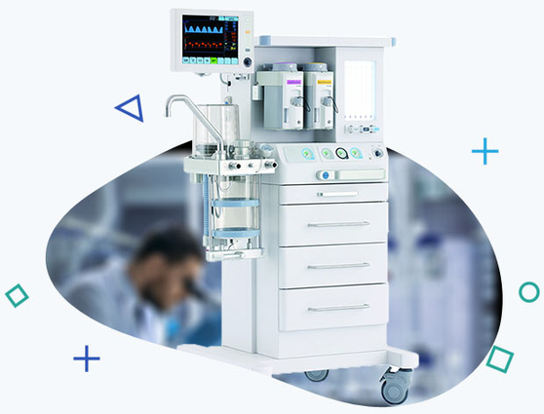
Key Offerings
Hospital lab equipment manufacturers provide a comprehensive range of advanced instruments essential for accurate diagnostics and smooth laboratory operations. This includes high-resolution microscopes, fully automated analyzers, high-speed centrifuges, temperature-controlled incubators, sterilizers, and other critical diagnostic tools. NaugraMedicals focuses on delivering equipment engineered for precision, durability, and consistent performance, ensuring hospitals maintain reliable testing environments.
Visit ,
https://www.naugramedical.com/

Slide 4
Thank
You
Address :- 6148/6, Guru Nanak Marg, Ambala Cantt, Haryana, India
Phone No :- +91-9896600003
Website :- www.naugramedical.com

