Slide 1



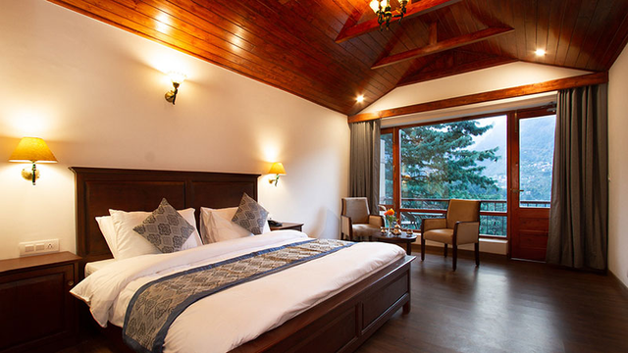

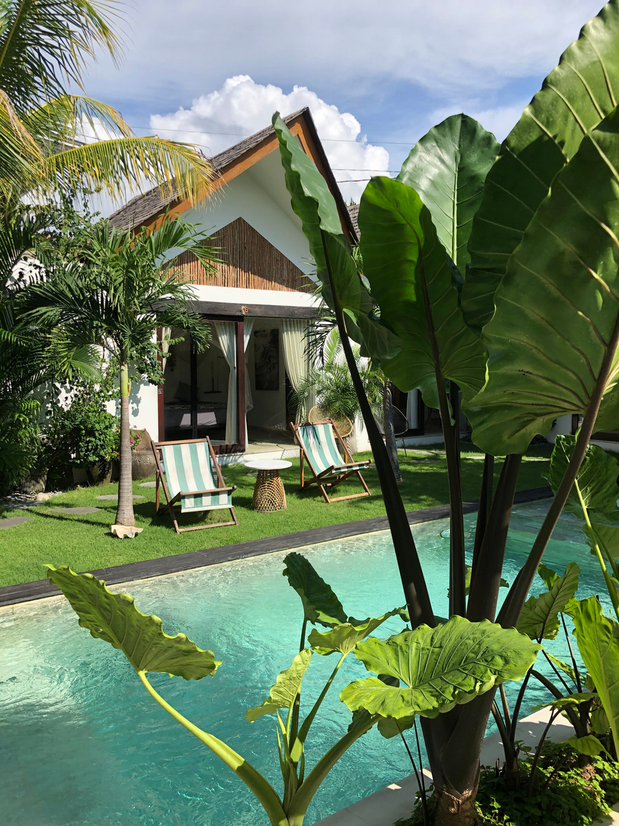
RESORT ROOM
BEST RESORT IN MANALI
Presented By , Aloka Resort
alokaresortmanali@gmail.com
BOOK NOW
alokaresortmanali.com

Slide 2
Overview
Aloka Resort is one of the best resorts in Manali, offering luxurious rooms, stunning mountain views, excellent services, and a peaceful ambiance. It provides the perfect stay for families, honeymooners, and travelers seeking comfort and unforgettable holiday experiences.
Why Aloka Resort is the Best Resort in Manali
  Breathtaking mountain views
  Luxurious rooms and suites
  World-class services
  Perfect location near major tourist spots
  True value for money

Slide 3
Modern & Luxurious Rooms
  Spacious interiors
  Elegant décor
  Premium bedding & furnishings
  Balcony views of the Himalayas
Facilities at Aloka Resort
  High-speed Wi-Fi
  Spa & wellness services
  Indoor & outdoor activities
  Room service
  Travel assistance

