Slide 1
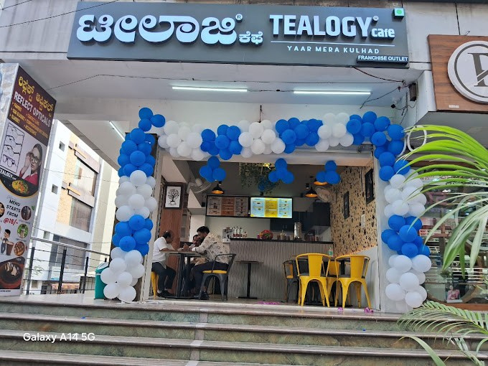

Cafe Franchise in Karnataka

Slide 2
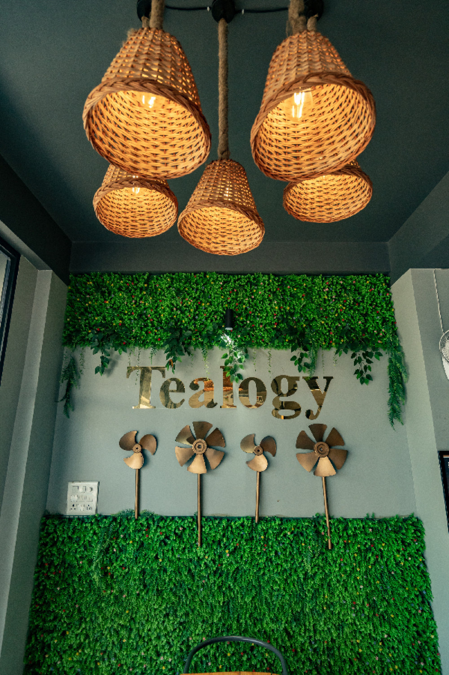
Top Benefits of Choosing Tealogy Tea Café Franchise
  Proven business model with strong brand recognition and market presence in Bangalore.
  Comprehensive support: location selection, staff training, design setup, and supply chain assistance.
  Low upfront investment with high return potential due to scalable café formats.
  Eco-friendly kulhad chai concept appeals to environmentally conscious and traditional tea lovers alike.
  Growing tea café demand in Bangalore ensures large customer base and business expansion opportunities.

Slide 3
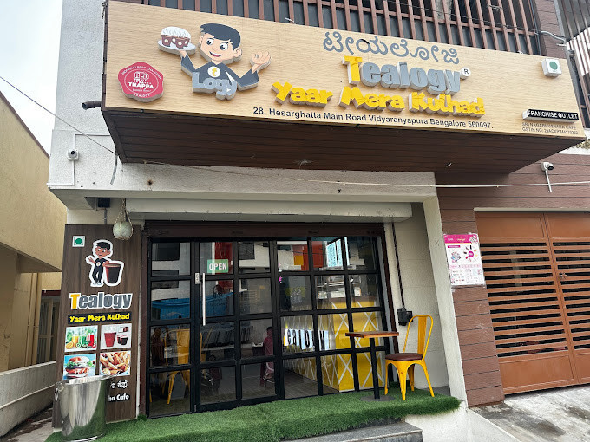
Visit - https://tealogy.in/state/tea-cafe-franchise-karnataka

Slide 4

Thank You
Visit - https://tealogy.in/state/tea-cafe-franchise-karnataka

