Slide 1

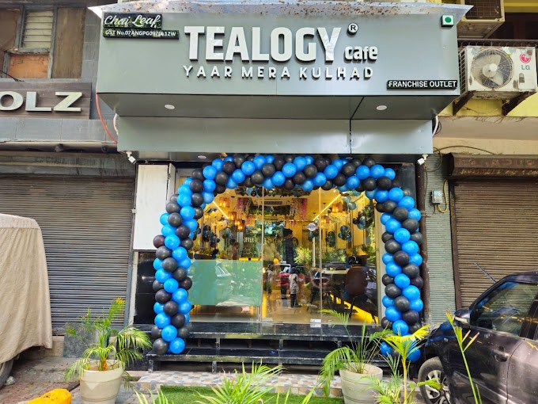
Tea Franchise in Mumbai
Visit - https://tealogy.in/city/tea-cafe-franchise-mumbai

Slide 2
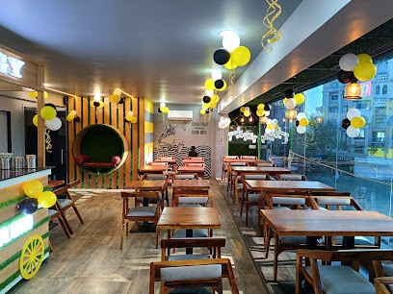
Tealogy’s Mumbai franchise offers a fusion of tradition and innovation, centring on its signature kulhad chai served in eco-friendly clay cups. With strong support in site-selection, training, and marketing, its proven business model appeals to entrepreneurs looking to join a beloved and growing tea-café network.

Slide 3
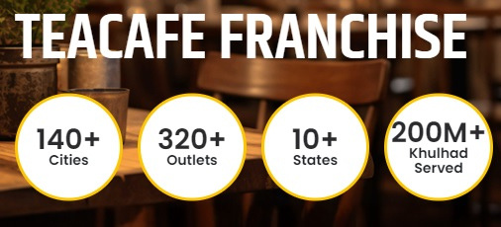
Visit - https://tealogy.in/city/tea-cafe-franchise-mumbai

Slide 4
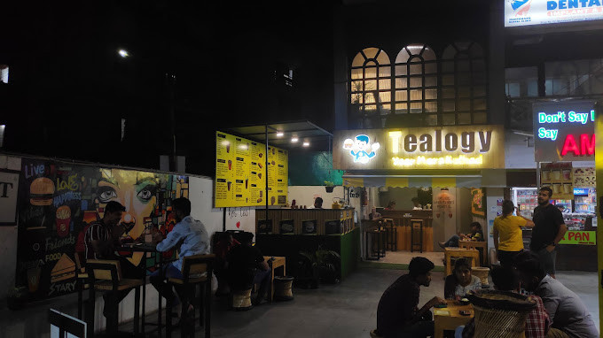
Thank You
Visit - https://tealogy.in/city/tea-cafe-franchise-mumbai

