Slide 1



Luxury Manali Resort
Experience Himalayan Elegance at AlokaResort
Presented By
ALOKA RESORT
Chadyari Tehsil Manali Distt Kullu H.P 175131 INDIA
+91 98160-76122
www.alokaresortmanali.com

Slide 2
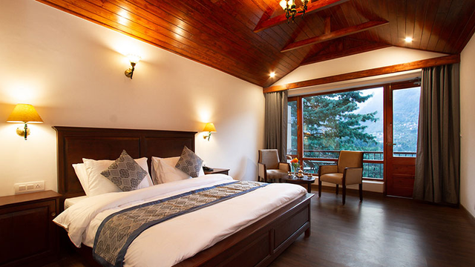

Introduction
Discover the true essence of luxury in Manali with AlokaResort, a premium getaway designed for travelers who seek serenity, style, and sophistication. Nestled amidst lush valleys and snow-kissed peaks, the resort blends modern comfort with warm Himachali hospitality.
AlokaResort is a premium luxury Manali resort offering stunning mountain views, elegant rooms, exceptional dining, and personalized hospitality. Enjoy a serene Himalayan escape with modern comforts and unforgettable experiences.

Slide 3

Luxury Amenities
  Mountain-view rooms & private balconies
  Spa, wellness center & indoor recreational spaces
  Premium dining experience with fresh, local ingredients
  Bonfire evenings, adventure assistance & travel desk
  High-speed Wi-Fi and modern in-room comforts

