Slide 1

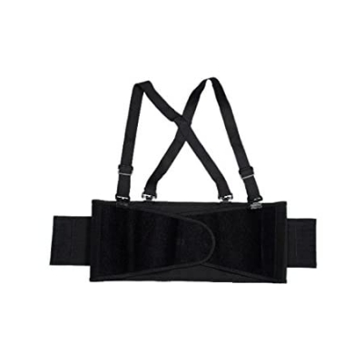



Rehabilitation Products & Aids Suppliers
Empowering Recovery with Innovation & Care
www.naugramedical.com

Slide 2
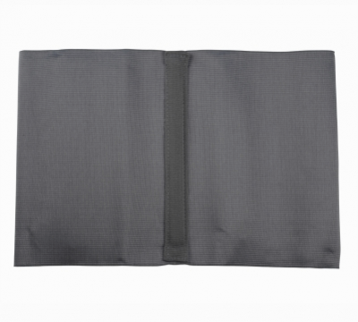
Introduction
NaugraMedicals is a trusted name among leading Rehabilitation Products & Aids Suppliers, providing high-quality and durable equipment designed to assist patients in their recovery journey. Our range supports physical therapy, post-surgery recovery, and daily mobility needs.
Visit ,
https://www.naugramedical.com/rehabilitation-products
www.naugramedical.com

Slide 3
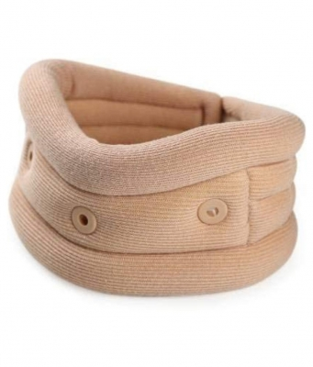
Our Product Range
  Wheelchairs and Walking Aids
  Orthopedic Supports and Braces
  Exercise & Therapy Equipment
  Physiotherapy Instruments
  Mobility and Daily Living Aids
www.naugramedical.com

Slide 4
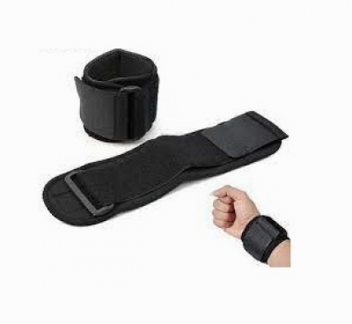
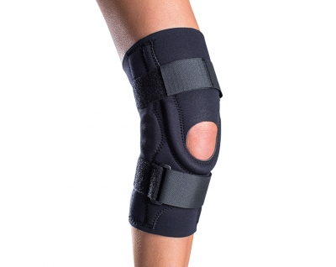
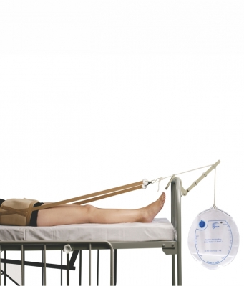
Why Choose NaugraMedicals
  Superior Quality and Reliability
  Wide Range of Certified Products
  Designed for Comfort and Safety
  Global Supply and Custom Solutions
  Affordable Prices with On-Time Delivery

Slide 5

Thank
You
Contact Information
Address :- 6148/6, Guru Nanak Marg, Ambala Cantt, Haryana, India
Phone No :- +91-9896600003
Website :- www.naugramedical.com

