Slide 1








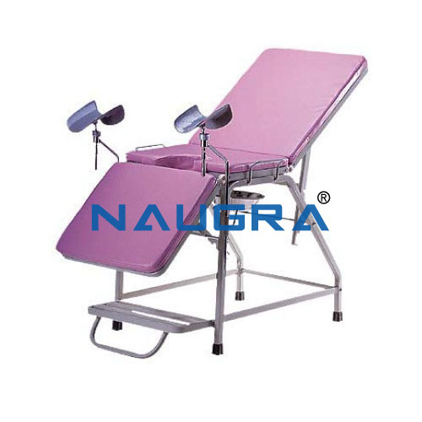

www.naugramedicals.com
+91-9896600003
Obstetric Tables Manufacturers
Presented By :
Naugra Medicals

Slide 2

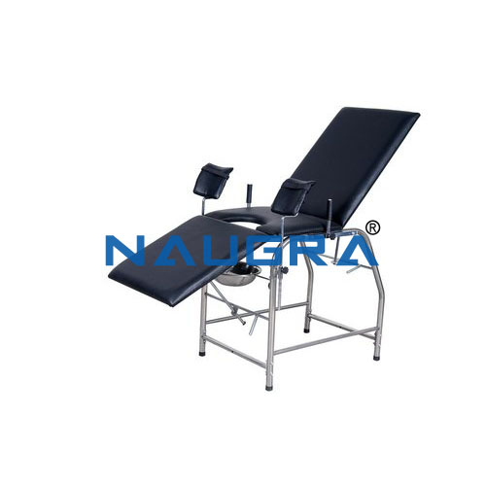




www.naugramedicals.com
+91-9896600003
INTRODUCTION
Welcome to NaugraMedicals, a trusted name among Obstetric Tables Manufacturers. We specialize in designing and producing high-quality obstetric tables that ensure comfort, safety, and efficiency during delivery and examination procedures.
Picture 1

Slide 3

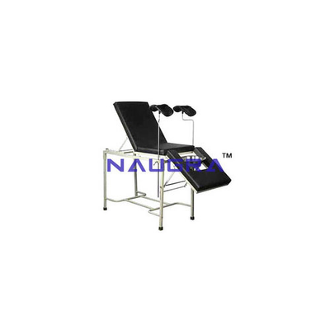
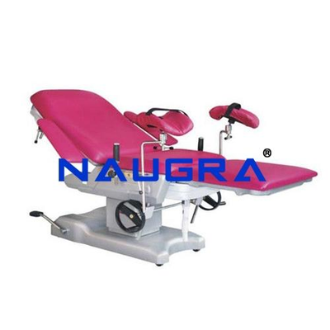
Fauget
ABOUT NAUGRAMEDICALS
  Leading global manufacturer and exporter of medical and hospital equipment
  Committed to superior quality, innovation, and durability
  Trusted by hospitals, clinics, and healthcare institutions worldwide
Picture 1
Picture 2

Slide 4
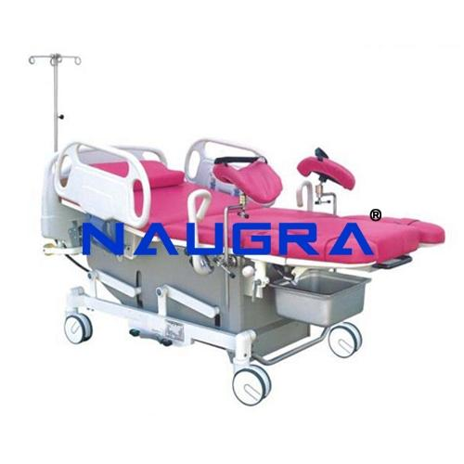
OUR OBSTETRIC TABLES
  Ergonomically designed for maximum patient comfort
  Adjustable height, backrest, and leg supports
  Durable stainless steel structure and easy-to-clean surfaces
  Designed for both gynecological and obstetric use
Visit:
https://www.naugramedical.com/hospital-medical-furniture/obstetric-tables

Slide 5


Thank You
Address :- 6148/6, Guru Nanak Marg, Ambala Cantt, Haryana, India
Phone No :- +91-9896600003
Website :- www.naugramedical.com

