Slide 1

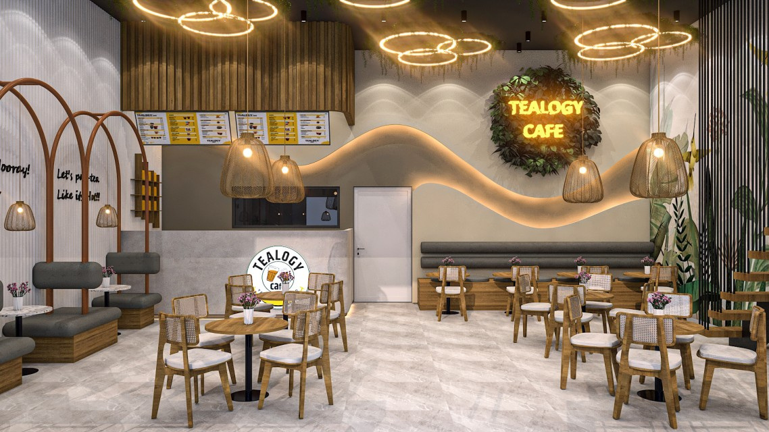
Cafe Franchise in Kolkata
Visit - https://tealogy.in/city/tea-cafe-franchise-kolkata

Slide 2
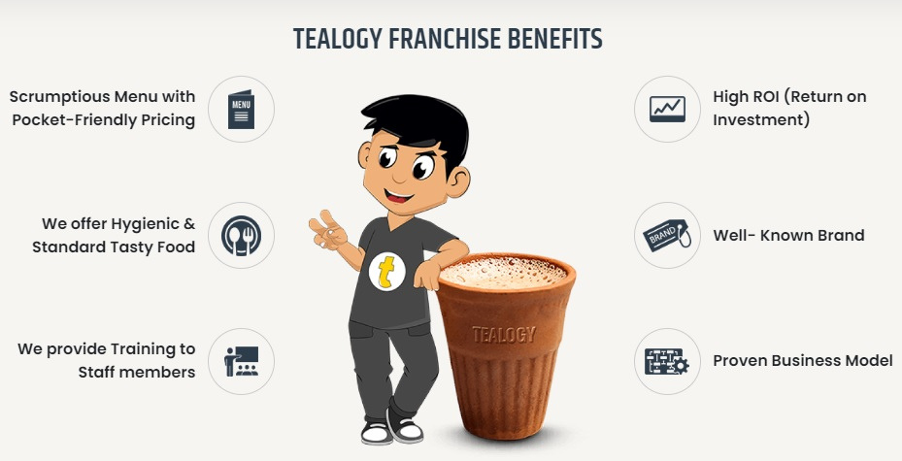
Tealogy’s Tea Café Franchise in Kolkata blends tradition with modern café culture. Serving authentic “kulhad chai,” it offers franchisees strong brand support, setup guidance, and marketing assistance. With Kolkata’s love for tea and vibrant atmosphere, this franchise ensures excellent customer engagement and profitable business growth in a culturally rich market.

Slide 3

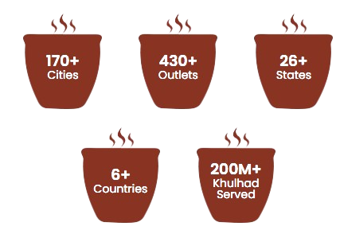
Address Details - 503-A/B, 5th Floor Princess Business Sky ParkBlock no. 23,24 SCH No.54, PU-3 Commercial,
Opp C21, AB Rd, Indore, Madhya Pradesh 452001
Contact Details - +91 6269116000 / 6269120500
Email: business@tealogy.in / franchise@tealogy.in
Visit - https://tealogy.in/city/tea-cafe-franchise-kolkata

Slide 4
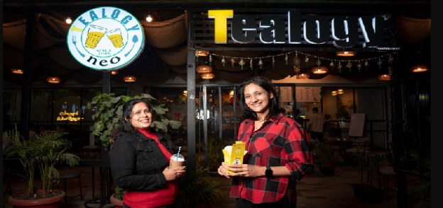
Thank You
Visit - https://tealogy.in/city/tea-cafe-franchise-kolkata

