Slide 1

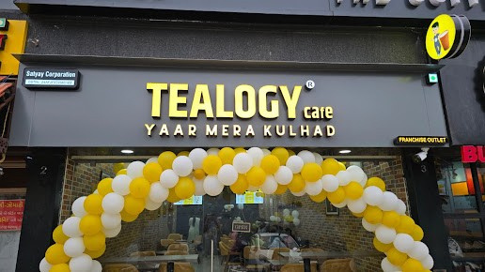
Small Cafe Franchise Opportunities
Visit - https://tealogy.in/teacafe-franchise

Slide 2

Key Highlights of the Tealogy Tea Café Franchise Opportunity
  Affordable investment models (pocket, medium, premium) cater to diverse entrepreneur budgets and ambitions.
  Established Indian tea-café brand founded in 2018, focused on tea-based beverages and snacks.
  Emphasis on high ROI, hygienic operations, and proven scalable franchise business model.
  Offers training, brand support, and menu standardization for consistent customer experience across outlets.
  Unique selling point: serving traditional kulhad tea with modern café ambiance across various sizes.

Slide 3
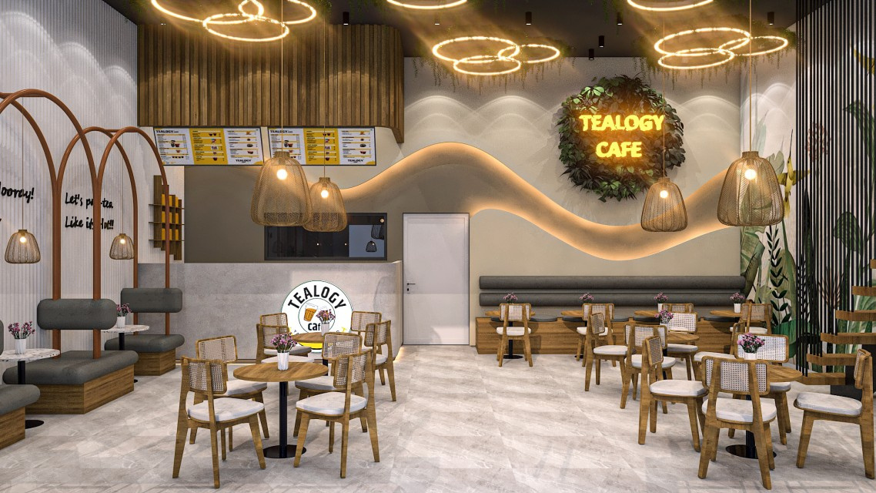
Address Details - 503-A/B, 5th Floor Princess Business Sky ParkBlock no. 23,24 SCH No.54, PU-3 Commercial,
Opp C21, AB Rd, Indore, Madhya Pradesh 452001
Contact Details - +91 6269116000 / 6269120500
Email: business@tealogy.in / franchise@tealogy.in
Visit - https://tealogy.in/teacafe-franchise

Slide 4
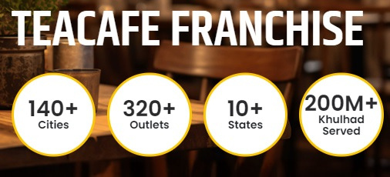
Thank You
Visit - https://tealogy.in/teacafe-franchise

