Slide 1

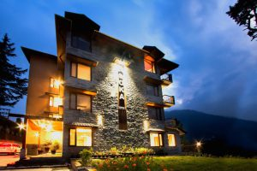
Luxury Manali Resort
alokaresortmanali@gmail.com
www.alokaresortmanali.com

Slide 2

Discover ultimate comfort at Aloka Resort, the finest Luxury Manali Resort surrounded by snow-capped peaks. Indulge in cozy stays, spa treatments, and gourmet dining while experiencing tranquility and scenic beauty in the heart of Manali.
Address :- Chadyari Tehsil Manali Distt Kullu H.P 175131 INDIA
Phone No. +91 98160-76122
E-mail us :- alokaresortmanali@gmail.com
Website :- https://www.alokaresortmanali.com/

