Slide 1




Resort in Manali

Slide 2




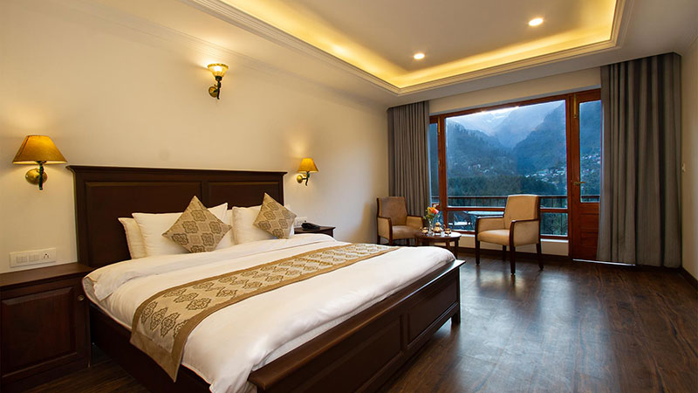
RESORT IN MANALI
For a luxurious stay in the lap of the Himalayas, choose Aloka Resort, a premium resort in Manali. Surrounded by breathtaking mountain views, it offers world-class amenities, warm hospitality, and serene comfort
Address :- Chadyari Tehsil Manali Distt Kullu H.P 175131 INDIA
Phone No. +91 98160-76122
E-mail us :- alokaresortmanali@gmail.com
Website :- https://alokaresortmanali.com/

