Slide 1




Best Resort in Manali
Chadyari
Tehsil Manali
Distt Kullu H.P
alokaresortmanali.com
ALOKARESORTMANALI@GMAIL.COM

Slide 2




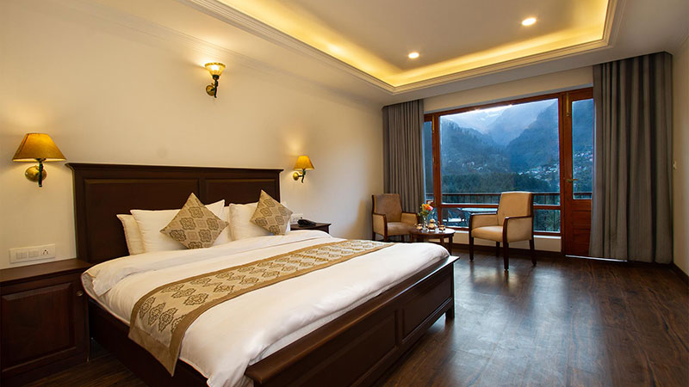
BEST RESORT IN MANALI
Discover the charm of the Himalayas at Aloka Resort, the best resort in Manali. Offering luxury stays, fine dining, modern amenities, and breathtaking views, Aloka Resort ensures a perfect blend of comfort, elegance, and unforgettable experiences.
Chadyari
Tehsil Manali
Distt Kullu H.P
175131 INDIA
+91 78386-09537
alokaresortmanali.com
alokaresortmanali@gmail.com

