Slide 1

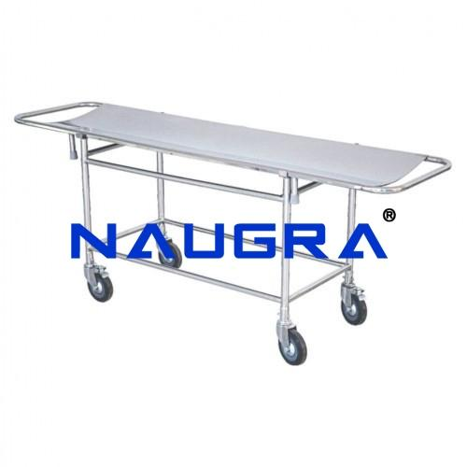
Medical Trolley Exporters
Trusted Global Partner in Healthcare Equipment
Powered by NaugraMedical

Slide 2
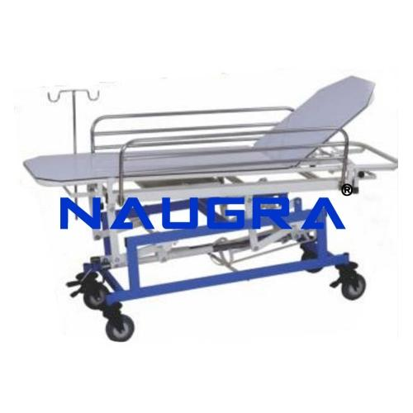
Introduction
  NaugraMedical is a leading medical trolley exporter with a strong presence in international markets.
  Offering durable, safe, and functional hospital trolleys for seamless healthcare operations.

Slide 3
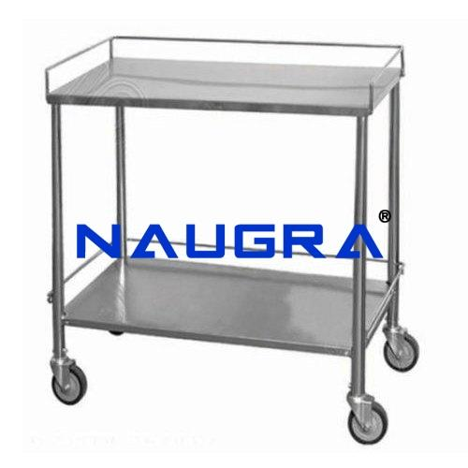
Product Range
  Emergency Trolleys
  Instrument Trolleys
  Dressing Trolleys
  Anesthesia Trolleys
  Customized Solutions

Slide 4
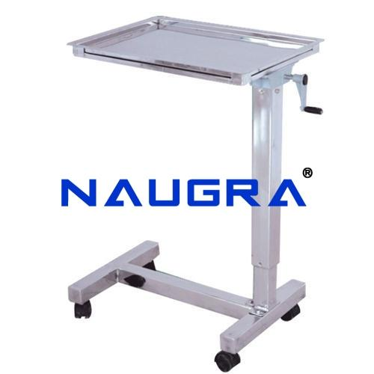
Key Features
  High-quality stainless steel & premium materials
  Smooth mobility with strong wheels
  Ergonomic design for safe handling
  Easy to clean & maintain
  Long-lasting durability

Slide 5
Thank you very much!
Contact Information
Address :- 6148/6, Guru Nanak Marg, Ambala Cantt, Haryana, India
Phone No :- +91-9896600003
Website :- www.naugramedical.com

