Slide 1


Low-Cost Coffee Franchise
Visit - https://tealogy.in/about-us

Slide 2
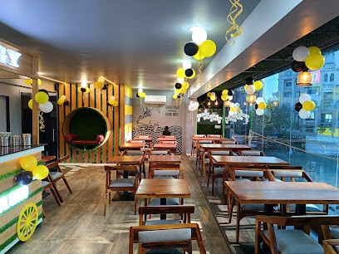
Tealogy, founded in 2018, fuses tradition and innovation through its kulhad chai and premium café culture. It offers low‑investment franchise models, zero plastic usage, biodegradable kulhads, and strong brand support for entrepreneurs. Certified, authentic, eco‑friendly, aiming to provide jobs and community impact.

Slide 3
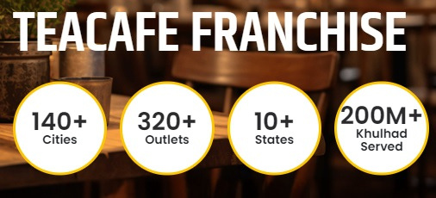
Address Details - 503-A/B, 5th Floor Princess Business Sky ParkBlock no. 23,24 SCH No.54, PU-3 Commercial,
Opp C21, AB Rd, Indore, Madhya Pradesh 452001
Contact Details - +91 6269116000 / 6269120500
Email: business@tealogy.in / franchise@tealogy.in
Visit - https://tealogy.in/about-us

Slide 4
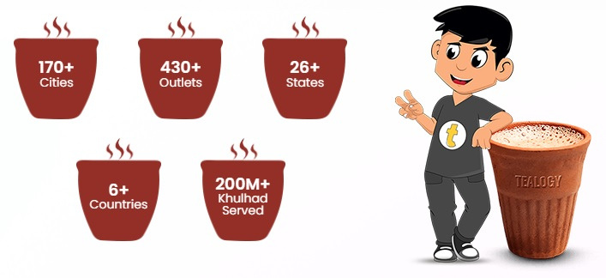
Thank You
Visit - https://tealogy.in/about-us/

