Slide 1
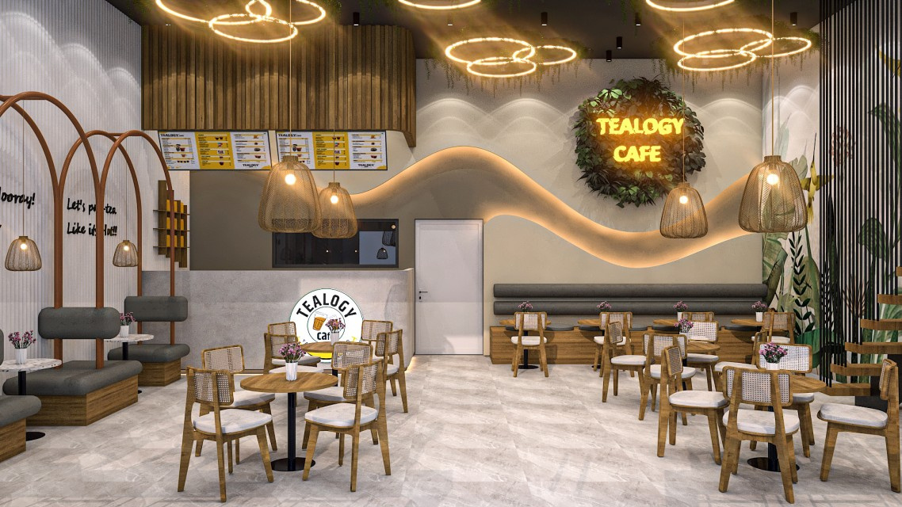

Top Kulhad Chai Franchise
Visit - https://tealogy.in/

Slide 2
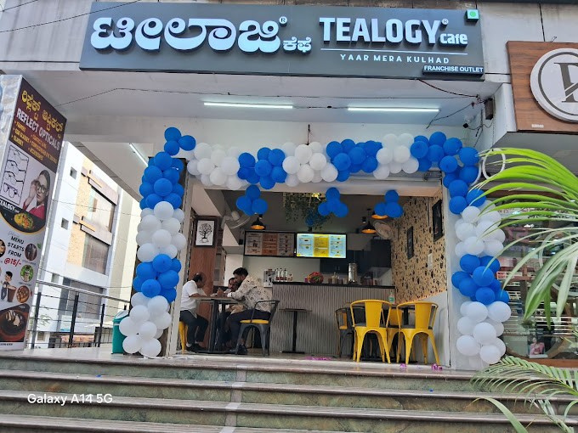
Tealogy is a modern Indian tea café franchise offering authentic kulhad chai experiences since 2018.
It boasts no royalty fees, premium ingredients, varied café models, and strong franchise support.Tealogy blends tradition with innovation, serving handcrafted teas in eco-friendly kulhads. With diverse menu options and attractive ROI, it’s ideal for entrepreneurs seeking a unique, culturally rich café franchise experience.

Slide 3
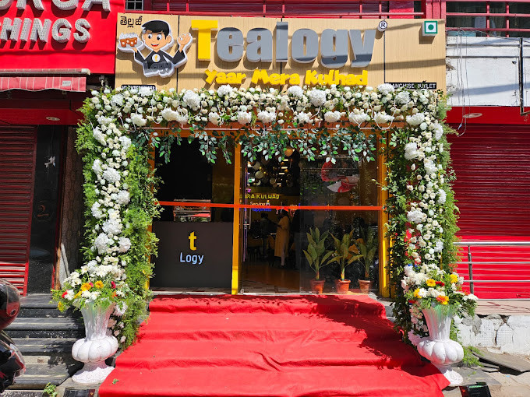
Address Details - 503-A/B, 5th Floor Princess Business Sky ParkBlock no. 23,24 SCH No.54, PU-3 Commercial,
Opp C21, AB Rd, Indore, Madhya Pradesh 452001
Contact Details - +91 6269116000 / 6269120500
Email: business@tealogy.in / franchise@tealogy.in
Visit - https://tealogy.in/

Slide 4


Thank You
Visit - https://tealogy.in/

