Slide 1


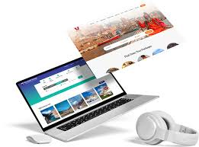

Tour Web Development in India
Powered by Travipro – Your Trusted Travel Technology Partner

Slide 2

Introduction
  Overview of the growing travel and tourism industry in India
  Importance of professional tour web development
  How Travipro helps tour operators establish a strong online presence
To know more about to visit official website , https://www.travipro.com/travel-website-development.html

Slide 3


Key Features by Travipro
  Customizable travel portals
  Real-time booking engine
  Integration with multiple payment gateways
  SEO-friendly design for higher rankings
  Secure and scalable solutions
To know more about to visit official website , https://www.travipro.com/travel-website-development.html

Slide 4


Why Tour Web Development?
  Seamless booking and reservation systems
  Enhanced customer engagement
  Boost in online visibility and sales
  Mobile-friendly, user-centric designs
To know more about to visit official website , https://www.travipro.com/travel-website-development.html

Slide 5
Contact information
Address :- B-112, Sector-64 Noida - 201301
EMail :- info@travipro.com
Ph.no :- +91 9560 433 318
Website :- https://www.travipro.com
To know more about to visit official website , https://www.travipro.com/travel-website-development.html

