Slide 1



Best Travel Portal Development Company India
Powered by Travipro

Slide 2

Introduction
  Travipro is a leading travel portal development company in India.
  Specializing in innovative and customized travel technology solutions.
  Helping businesses simplify operations and enhance customer experience.
To know more about to visit official website , https://www.travipro.com/travel-portal-development.html

Slide 3
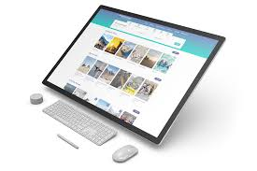
Our Services
  Flight Booking Portal Development
  Hotel Booking Systems
  Car Rental Solutions
  B2B & B2C Travel Portals
  White Label Travel Solutions
  API Integration & Payment Gateway
To know more about to visit official website , https://www.travipro.com/travel-portal-development.html

Slide 4
Thank You
So Much!
Contact information
Address :- B-112, Sector-64 Noida - 201301
EMail :- info@travipro.com
Ph.no :- +91 9560 433 318
Website :- https://www.travipro.com

