Slide 1


BEST TRAVEL WEBSITE DEVELOPMENT COMPANY – TRAVIPRO
Crafting World-Class Travel Portals & Websites
Delivering innovation, technology, and seamless user experiences

Slide 2
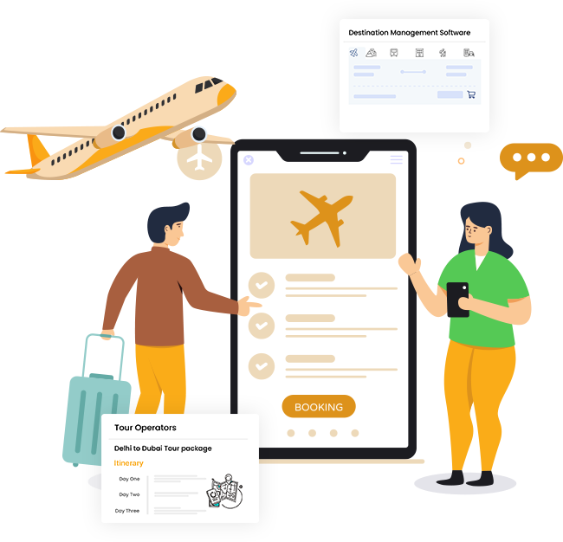
About Travipro
  Travipro is a leading Travel Website Development Company with global expertise
  Specialized in building responsive, user-friendly, and feature-rich travel portals
  Trusted by travel agencies, tour operators, and startups worldwide
  Committed to innovation, scalability, and cost-effective solutions
TO KNOW MORE VISIT TO OFFICIAL WEBSITE , HTTPS://WWW.TRAVIPRO.COM/TRAVEL-WEBSITE-DEVELOPMENT.HTML

Slide 3

Travipro’s Core Services
  Custom Travel Website Development
  B2B & B2C Travel Portal Solutions
  Hotel, Flight, Cab & Bus Booking System Integration
  White Label Travel Solutions
  Mobile-Friendly & SEO-Optimized Websites
TO KNOW MORE VISIT TO OFFICIAL WEBSITE , HTTPS://WWW.TRAVIPRO.COM/TRAVEL-WEBSITE-DEVELOPMENT.HTML

Slide 4
Thank you very much!
Address :- B-112, Sector-64 Noida - 201301
EMail :- info@travipro.com
Ph.no :- +91 9560 433 318
Website :- https://www.travipro.com

