Slide 1
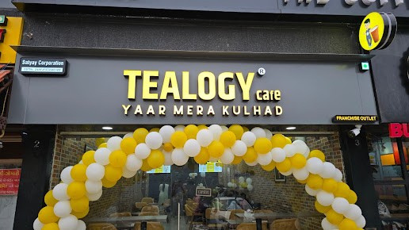

Top Tea Franchise
Visit - https://tealogy.in/

Slide 2

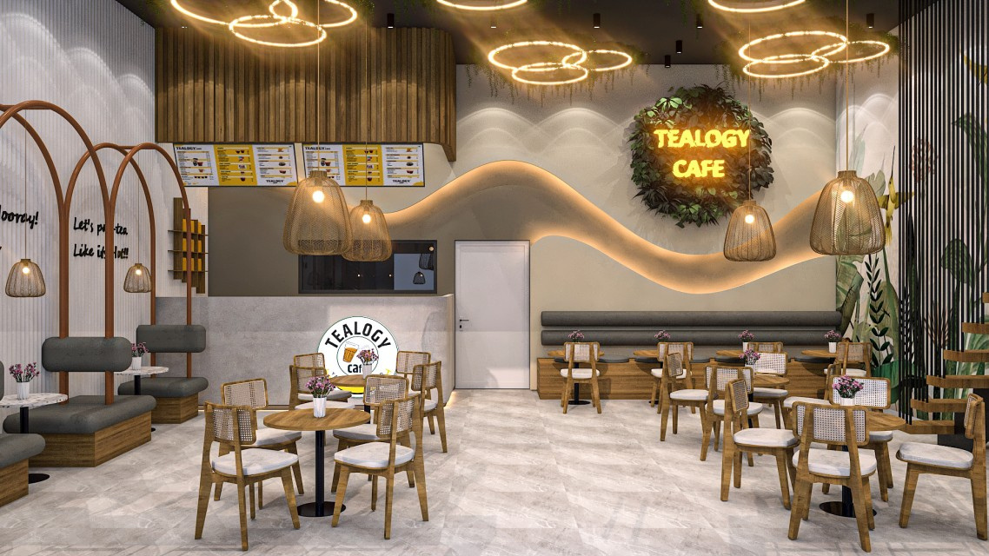
Tealogy is a fast‑growing Indian tea‑café franchise (founded 2018, Indore), renowned for authentic kulhad‑served chai, eco-conscious practices, strong franchise support, and widespread national presence.

Slide 3

Address Details - 503-A/B, 5th Floor Princess Business Sky ParkBlock no. 23,24 SCH No.54, PU-3 Commercial,
Opp C21, AB Rd, Indore, Madhya Pradesh 452001
Contact Details - +91 6269116000 / 6269120500
Email: business@tealogy.in / franchise@tealogy.in
Visit - https://tealogy.in/

Slide 4

Thank You
Visit - https://tealogy.in/

