Slide 1

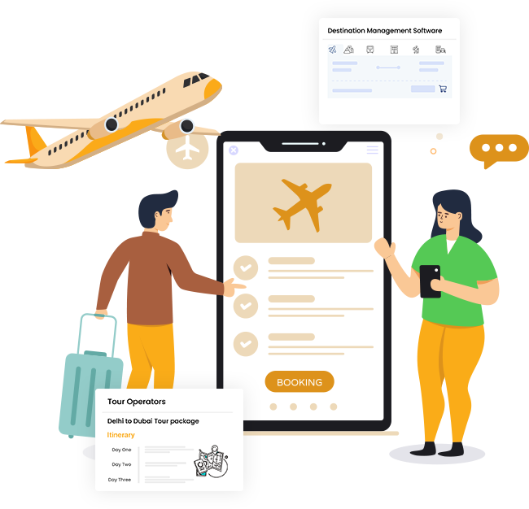
TRAVEL Portal Software Solutions
Empowering the Travel Industry with Technology
www.Travipro.com

Slide 2

INTRODUCTION
  Travel Portal Software Solutions streamline online booking and management.
  Enables travel agencies, tour operators, and enterprises to provide seamless services.
  Covers flights, hotels, car rentals, holiday packages, and more.
  Enhances customer experience with advanced features and real-time updates.
TO KNOW MORE ABOUT TRAVIPRO TO VISIT OFFICIAL WEBSITES , HTTPS://WWW.TRAVIPRO.COM/TRAVEL-WEBSITE-DEVELOPMENT.HTML

Slide 3
KEY FEATUres of Travel Portal Software
  Flight, Hotel, Bus, and Car Rental Booking Integration
  Real-Time API & GDS Connectivity
  Multiple Payment Gateway Integration
  Multi-Language & Multi-Currency Support
  Customizable & Scalable Solutions
TO KNOW MORE ABOUT TRAVIPRO TO VISIT OFFICIAL WEBSITES , HTTPS://WWW.TRAVIPRO.COM/TRAVEL-WEBSITE-DEVELOPMENT.HTML

Slide 4
TRAVEL PORTAL SOFTWARE BY TRAVIPRO
  Travipro delivers cutting-edge Travel Portal Software Solutions for agencies and startups.
  Fully tailored platforms with robust features.
  Focused on scalability, reliability, and user-friendly design.
  Helping businesses transform into successful digital travel brands.

Slide 5

CONTACT US
Address :- B-112, Sector-64 Noida - 201301
EMail :- info@travipro.com
Ph.no :- +91 9560 433 318
Website :- https://www.travipro.com

