Slide 1


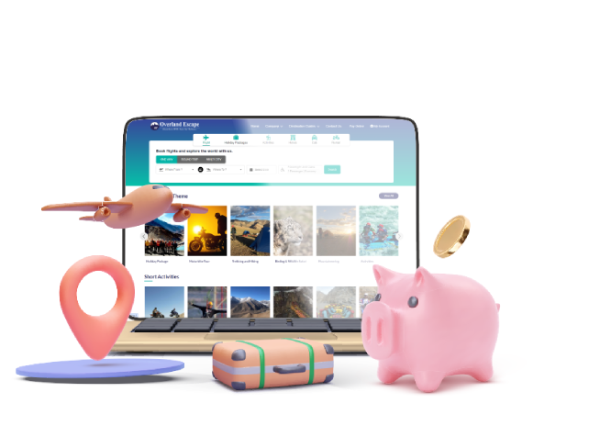

Flight Booking Portal Development in India
www.Travipro.com

Slide 2
Introduction
Revolutionizing Air Travel Booking
In today’s competitive travel industry, a robust flight booking portal is essential for travel agencies and businesses to provide quick, secure, and user-friendly ticketing services. Travipro delivers cutting-edge flight booking portal development solutions in India, designed for scalability, efficiency, and superior customer experience.
To Know more about Travipro to visit official website
, https://www.travipro.com/flight-booking-portal-development.html

Slide 3
Key Features
Core Functionalities We Offer
  Real-time Flight Search & Booking – Instant results from multiple airlines with Travipro’s advanced technology.
  Global Distribution System (GDS) Integration – Access to Amadeus, Sabre, Galileo, and more.
  Multiple Payment Gateways – Secure and convenient transactions powered by Travipro.
  Multi-Language & Multi-Currency Support – Reach customers worldwide.
  Customizable Interface – Tailored design that reflects your brand with Travipro’s creative touch.
To Know more about Travipro to visit official website
https://www.travipro.com/flight-booking-portal-development.html

Slide 4
Benefits for Travel Businesses
  Boost operational efficiency with Travipro’s automated processes.
  Enhance customer satisfaction through fast and easy bookings.
  Expand business reach with global connectivity.
  Reduce manual errors and save time.
  Increase revenue through dynamic pricing and add-on services by Travipro.

Slide 5





THANK TOU
For watching this presentation
Travipro
+91 9560 433 318
www.travipro.com
info@travipro.com
B-112, Sector-64 Noida - 201301

