Slide 1



Luxury Resorts in Manali
Experience the perfect blend of comfort, elegance, and Himalayan charm
https://alokaresortmanali.com/

Slide 2

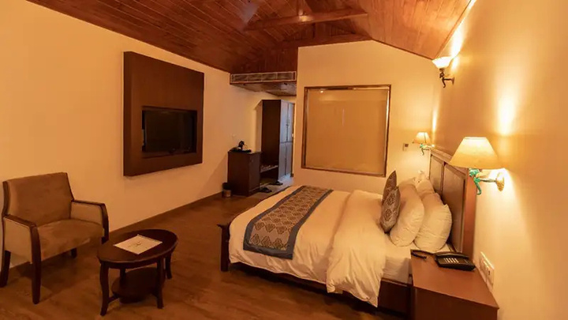
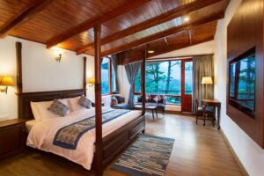
Introduction
Manali, nestled in the heart of the Himalayas, is a haven for travelers seeking scenic beauty, adventure, and relaxation. Among its finest stays, Aloka Resort stands out for its unmatched hospitality, breathtaking views, and elegant design, offering guests a truly luxurious escape.
https://alokaresortmanali.com/

Slide 3

Aloka Resort & Signature Experiences
Aloka Resort is one of Manali’s most prestigious luxury retreats, combining elegance, comfort, and nature’s charm. Guests can enjoy:
  Well-appointed rooms with panoramic Himalayan views
  Modern amenities, wellness facilities, and spa treatments
  Adventure activities like trekking, skiing, and river rafting
  Romantic bonfire evenings under the stars
  Guided local tours to explore Manali’s culture and heritage
https://alokaresortmanali.com/

Slide 4
THANK YOU!
Book Your Stay at Aloka Resort
Aloka Resort – Luxury Resorts Manali
📍 Chadyari Tehsil Manali Distt Kullu H.P 175131 INDIA
📞 +91 98160-76122
📧 alokaresortmanali@gmail.com
🌐 https://alokaresortmanali.com

