Slide 1


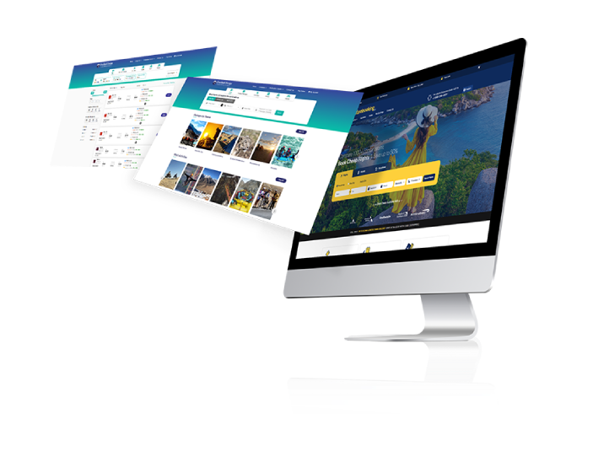
Hotel Website Development Company India
Empowering Hotels with Digital Excellence
www.travipro.com

Slide 2

Introduction
India’s hotel industry is evolving digitally. A specialized hotel website development company like Travipro helps hotels create user-friendly, mobile-responsive, and feature-rich websites to attract direct bookings, increase online visibility, and improve customer engagement.
To Know More Visit , https://www.travipro.com/hotel-website-development.html

Slide 3

Key Features of a Hotel Website
  Interactive Room Gallery & Virtual Tours
  Live Room Availability & Pricing Updates
  Integrated CRM & Channel Manager
  Social Media Integration
  Review & Testimonial Section
  Google Maps & Contact Form
To Know More Visit , https://www.travipro.com/hotel-website-development.html

Slide 4
Why Travipro for Hotel Web Development?
  Proven track record in travel and hotel tech solutions
  Scalable web solutions for independent hotels to large chains
  Expertise in API integration (OTA, GDS)
  Affordable pricing with fast deployment
  Dedicated support & maintenance services
To Know More Visit , https://www.travipro.com/hotel-website-development.html

Slide 5
CONTACT US
Alliance Web Solution Pvt Ltd.
B-112, Sector-64 Noida - 201301
+91 9560 433 318
info@travipro.com
www.travipro.com

