Slide 1



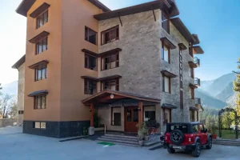

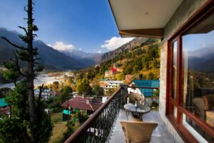
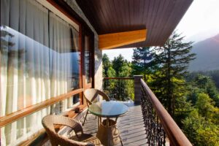
Luxury Resorts in Manali
MAKE YOUR WONDERFUL STORIES TO TELL WITH THE WORLD!
www.alokaresortmanali.com

Slide 2
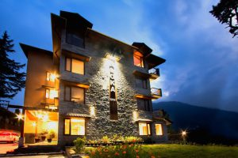
Welcome to Luxury – Discover Manali’s Finest Resorts
Experience the charm of Manali in the lap of luxury. From snow-clad peaks to serene pine forests, Manali is home to some of the finest resorts—offering elegance, peace, and adventure. Among them, Aloka Resort stands tall as a perfect blend of Himalayan beauty and modern luxury.
VISIT NOW!
www.alokaresortmanali.com

Slide 3
Why Choose a Luxury Resort in Manali?
  Stunning Locations: Wake up to mesmerizing mountain views.
  Modern Comforts: Spa, fine dining, and curated experiences.
  Exclusive Privacy: Ideal for romantic and family getaways.
  Adventure-Ready: Close to skiing, river rafting, and trekking trails.
Aloka Resort, in particular, offers these luxuries with personalized care and signature hospitality.
www.alokaresortmanali.com

Slide 4
Guest Testimonials – Why Guests Love Aloka Resort
  A luxurious stay with breathtaking views.
  The service was top-notch and the food was amazing.
  Aloka Resort made our honeymoon truly special.
www.alokaresortmanali.com

Slide 5



THANK YOU
Chadyari, Tehsil Manali, Distt Kullu H.P, 175131
+91 78386-09537
alokaresortmanali.com

